Slide 1
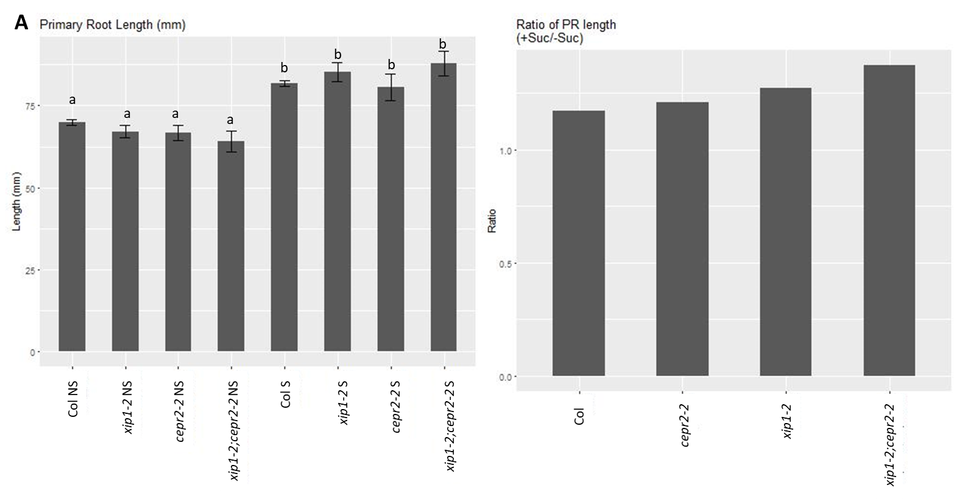
Figure S1A: PR length
Notes:
Figure S1A. Primary root lengths and fold change in primary root length in response to 1% sucrose. (two-way ANOVA followed by pairwise t-test with Bonferroni correction, NS – no sucrose, S – 1% sucrose, n= 15 for each mutant, 115 for Col)
Col

Slide 2
Figure S1B: LRP staging (LRP/mm PR as percentage of total)
B
Col
cepr2-2
xip1-2
xip1-2;cepr2-2
Col
cepr2-2
xip1-2
xip1-2;cepr2-2
Col
cepr2-2
xip1-2
xip1-2;cepr2-2
Col
cepr2-2
xip1-2
xip1-2;cepr2-2
Notes:
Figure S1B. Lateral root primordia staging for plants grown on 0.5X MS media and 0.5X MS media supplemented with 1% sucrose (N=15 for mutants, 115 for Col)

Slide 3
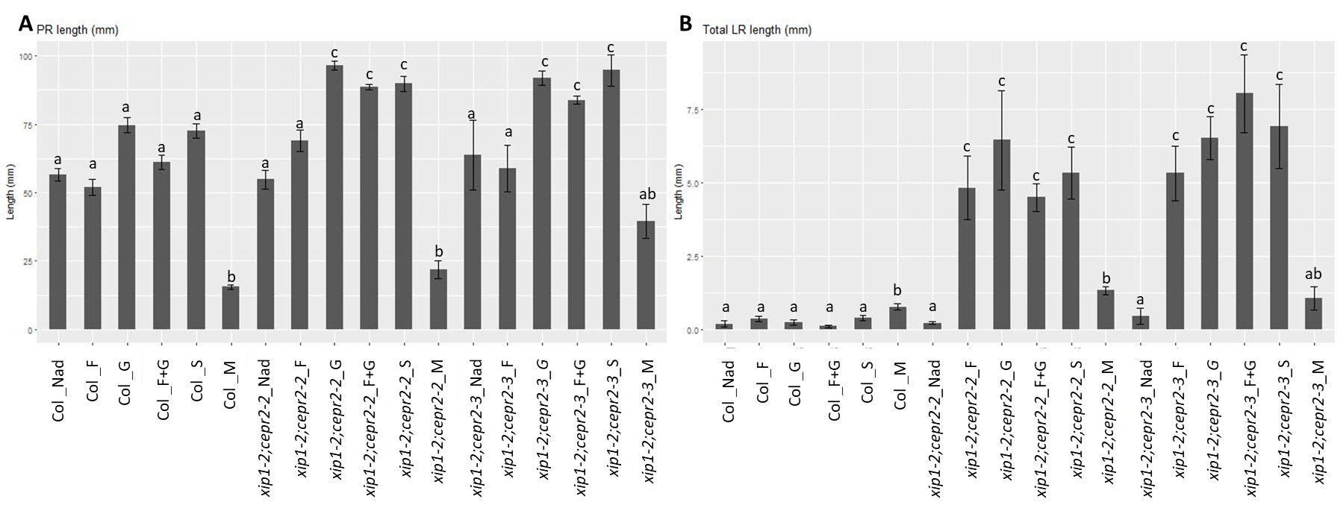
Figure S2
Notes:
Figure S2. Responses to a range of saccharides. (A) Average primary root length (B) total LR length. Plants were grown on 0.5X MS (NAd) or 0.5X MS supplemented with either 30mM glucose (_G), 30mM fructose (_F), 30 mM sucrose (equivalent to 1%, _S), 30 mM glucose and 30 mM fructose (_F+G), or 30mM mannitol (_M). (Kruskal-Wallis test followed by pairwise Wilcox with Bonferroni correction, n = 14, 15, 15, 13, 14, 14, 13, 15, 14, 14, 15, 14, 4, 9, 11, 10, 11, 4 respectively)

Slide 4
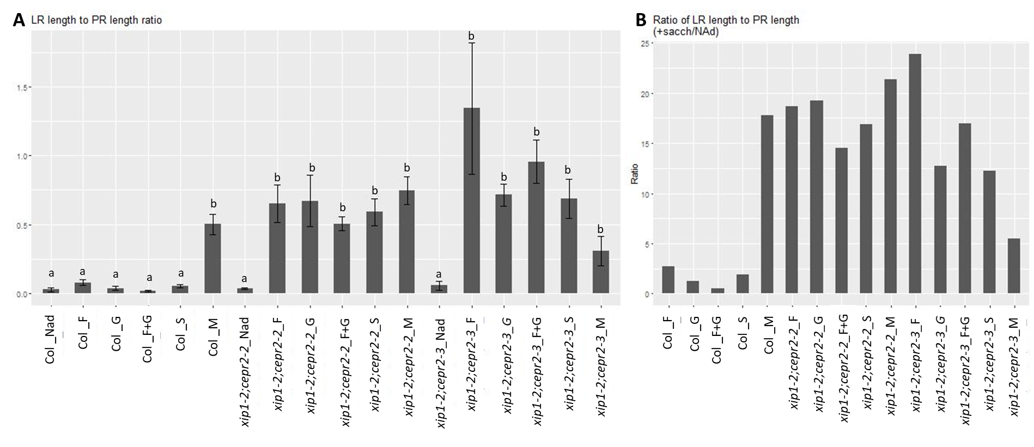
Figure S3
Notes:
Figure S3. Responses to a range of saccharides. (A) Lateral root length to primary root length ratio when grown on 0.5X MS (NAd) or 0.5X MS supplemented with either 30mM glucose (_G), 30mM fructose (_F), 30 mM sucrose (equivalent to 1%, _S), 30 mM glucose and 30 mM fructose (_F+G), or 30mM mannito (_M). (Kruskal-Wallis test followed by pairwise Wilcox with Bonferroni correction, n = 14, 15, 15, 13, 14, 14, 13, 15, 14, 14, 15, 14, 4, 9, 11, 10, 11, 4 respectively) (B) Fold change in lateral root length to primary root length ratio in this experiment.

Slide 5
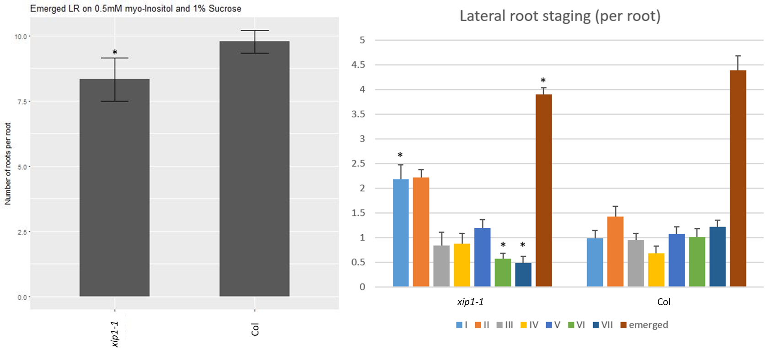
Figure S4
Notes:
Figure S4. Number of emerged lateral roots and lateral root primordia staging of xip1-1 and Col plants when grown on 0.5X MS media with 1% sucrose, and 0.5 mM myoinositol (Student’s t-test xip1-1 vs Col, *- p<0.05, n = 9)

Slide 6
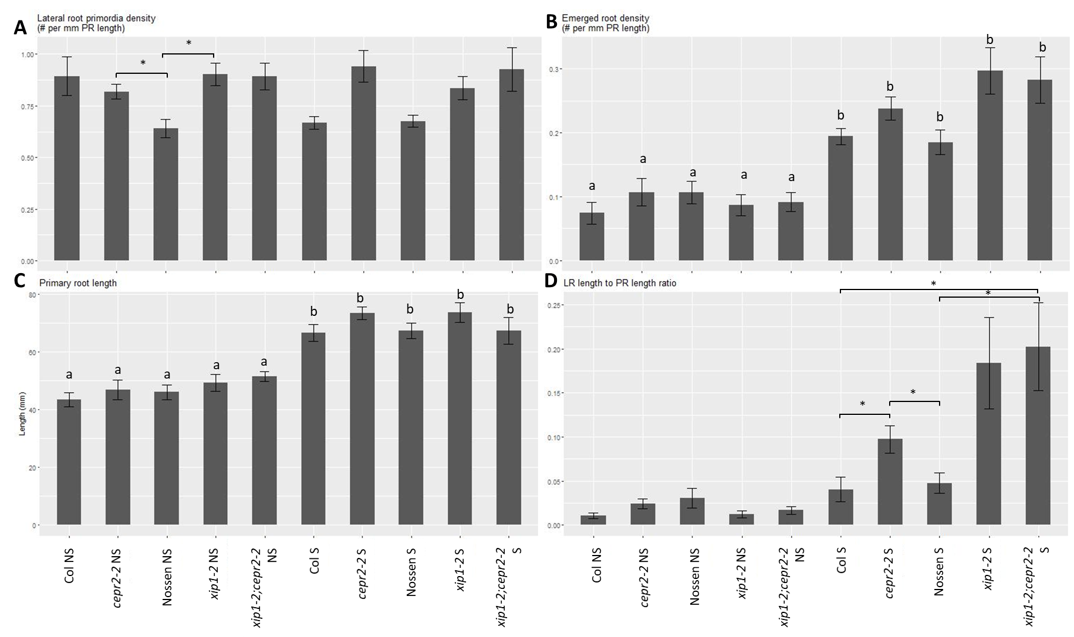
Figure S5
Notes:
Figure S5. The Nossen ecotype does not vary significantly when compared to Col under our growth conditions. (Kruskal-Wallis Rank Sum Test followed by pairwise comparisons using Wilcoxon rank sum test and Benjamini & Hochberg correction; * - p<0.05; error bars represent standard error; n = 14,16,14,16,15,11,14,14,10,14 respectively)

Slide 7
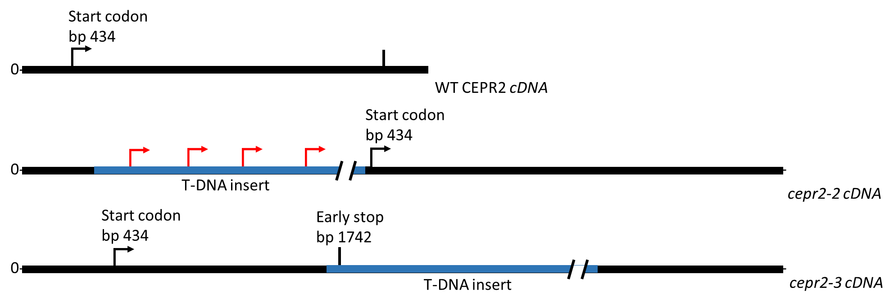
Figure S6
Notes:
Figure S6. cDNA models for cepr2-2 and cepr2-3. Based on our RT_PCR analysis, the insertion in cepr2-2 produces mRNA with several new early start codons (approximately 745 bp, 1252 bp, 1600 bp and 1787 bp downstream from the 5’ end of the CEPR2 mRNA, and upstream of the CEPR2 start codon). The insertion in cepr2-3 produces mRNA with a premature stop codon before the transmembrane and kinase domain of the protein.

