Slide 1
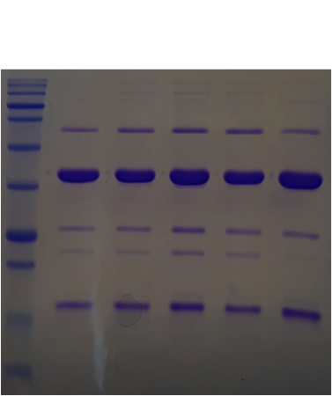
A.
B.
Cascade-
crRNAZERO
Cascade-crRNA1
Cascade-
crRNA2
Cascade-
crRNA1
CasA
CasC
CasD
CasE
CasB
Cascade-crRNAzero
Suppl. Figure 1. (A). SDS-PAGE analysis of purified Cascade complexes utilized in this work as labeled. (B). A gel filtration step
utilized during purification of Cascade complexes showed that Cascade-crRNAZERO and Cascade–crRNA1 eluted in the same
positions although Cascade-crRNAZERO contained more impurities at this stage of the purification, as indicated by the less well-
defined protein peak.

