Slide 1
Av
Ap
Ar
Au
D
Nutlin
Figure S1. Chemical structures of ISMBDs (Av, Ap, Ar, Au, D). Nutlin-3A structure is shown for illustrative purposes.

Slide 2
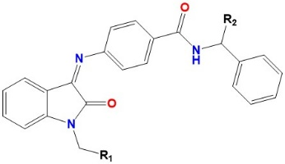
Table S1. Properties of ISMBDs
IMSBDs | R₁, R₂, | logS | logP |  | SASA |  | Metab*
Av | Bn-piperazine, Me | 5.4 |  | 5.3 |  | 985 | 5
Ap | Bn-piperidine, H | 6.1 |  | 6.1 |  | 873 | 3
Ar | Bn-piperazine, H | 5.7 |  | 4.8 |  | 960 | 4
An | Ph-piperazine, H | 7.0 |  | 5.3 |  | 923 | 2
Au | 2-F-Ph-piperazine, H | 7.2 |  | 5.4 |  | 927 | 2
D | methylbenzylamine, H | 6.2 |  | 5.2 |  | 875 | 3
2 | BDB-piperazine, H | 5.2 |  | 5.3 |  | 965 | 4
* - a number of metabolic reactions
SASA – solvent accessible surface area
LogS – solubility
LogP – octanol/water distribution coefficient
Figure S2. Shown above is the generic structure of ISMBD with radicals (R1 and R2). Table S1 deciphers radicals (R1 and R2) of ISMBDs in standard chemical definitions. Other abbreviations are deciphered below.

Slide 3
CCCCGACCCCCAAAAACCACCGCGCGGATTTCTGGCGTGCCAAGCTAGTCGACCTCGAGAACATGTCCCAACATGTTGTC 8800
8721 GGGGCTGGGGGTTTTTGGTGGCGCGCCTAAAGACCGCACGGTTCGATCAGCTGGAGCTCTTGTACAGGGTTGTACAACAG 8800
SalI XhoI PciI PciI
p21 p21 p21
8801 GAGAACATGTCCCAACATGTTGTCGAGAACATGTCCCAACATGTTGTCGAGAACATGTCCCAACATGTTGTCGAGGGACA 8880
8801 CTCTTGTACAGGGTTGTACAACAGCTCTTGTACAGGGTTGTACAACAGCTCTTGTACAGGGTTGTACAACAGCTCCCTGT 8880
PciI PciI PciI PciI PciI PciI
8881 TGCCCGGGCATGTCCACGTTTGCCTTGCATGGACTTGCCTGGCCTTGCCTTGATCCACTAGTAGATCCATATCGAGCGGG 8960
8881 ACGGGCCCGTACAGGTGCAAACGGAACGTACCTGAACGGACCGGAACGGAACTAGGTGATCATCTAGGTATAGCTCGCCC 8960
XmaI SpeI BsrBI
SrfI
SmaI
Hsp70 promotor EGFP →
8961 TCTCCGTGACGACTATAAAAGCCCAGGGGCAAGCGGTCCGAAGCTTATGCCCGCCATGAAGATCGAGTGCCGCATCACCG 9040
8961 AGAGGCACTGCTGATATTTTCGGGTCCCCGTTCGCCAGGCTTCGAATACGGGCGGTACTTCTAGCTCACGGCGTAGTGGC 9040
Figure S3. Structural elements in the promoter of pLV1 reporter plasmid. Shown are: underlined green
sequences indicate p21 consensus sites for p53 binding; blue letters represent the sequence of minimal
HSP70 promoter; red letters indicate start site for GFP.

Slide 4
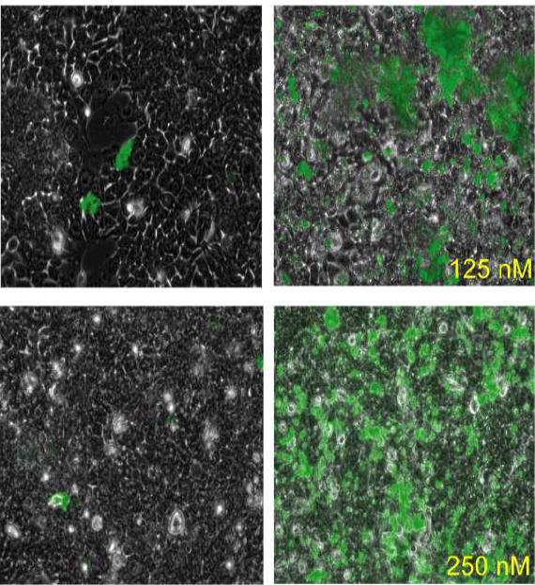
HCT116 cells (p53+)
control
CPT-treated
Figure S4. HCT116 cells (p53+) were treated with the indicated amounts of campthotecin (CPT) for 24 hrs.
GFP-positive cells were visualized by microscopy.

Slide 5
DAPI γ-H2Ax
non-treated
DAPI γ-H2Ax
Doxo
DAPI γ-H2Ax
DMSO
DAPI γ-H2Ax
Nutlin
DAPI γ-H2Ax
2
DAPI γ-H2Ax
An
DAPI γ-H2Ax
Ap
DAPI γ-H2Ax
Ar
DAPI γ-H2Ax
Au
DAPI γ-H2Ax
Av
DAPI γ-H2Ax
d
Figure S5. Immunofluorescence microscopy of p53+ U2-OS cells stained for γ-H2Ax foci. Cells were treated with ISMBDs as well as Nutlin-3a and doxorubicin used as positive controls. Green fluorescence: γ-H2Ax; blue fluorescence: DAPI. Scale: 25 μM.

Slide 6
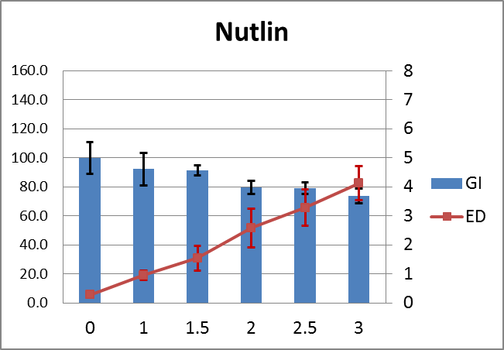
% of GFP-
positive cells
% of cells
Figure S6. Effective concentrations of Growth Inhibition (GI50) and Effective Dose (ED50) were calculated for indicated compounds that inhibit U2-OS cell growth and activate p53 in a concentration dependent manner. A concentration range from 1 μM to 3 μM was used. Histograms show percentages of survived cells (left axis). Percent of GFP-positive cells were plotted versus the compound concentration as line graphs (right axis). The data shown are mean of + SD.

Slide 7
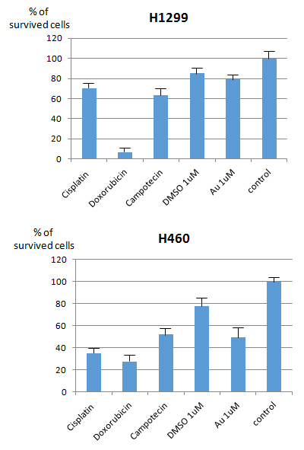
Figure S7. Two lung tumour cell lines that differ in their p53 status (A) H1299 p53- and (B) H460 p53+ respectively, were treated for 3 days with 1 μM of Au to assess its cytotoxicity. In addition, three known genotoxic agents (0.5 μM doxorubicin, 10 μM camptothecin and 10 μg/ml cisplatin) were used as controls. SD are shown.

Slide 8
4T1
Au
M
4T1 DMSO
Ct26 DMSO
CT26 Au
HSC70
p53
*
*
p53
Figure S8. Two different mouse cell lines that correspond to mammary (4T1) and colon (CT26) tumors, respectively, with different status of p53 were treated with DMSO as control or the compound Au (5µM) for24 hrs.
The bands that correspond to Hsc70 (loading control) and p53 are indicated by arrows. Non-specific bands are indicated by asterics. M denotes the marker lane.

