Slide 1
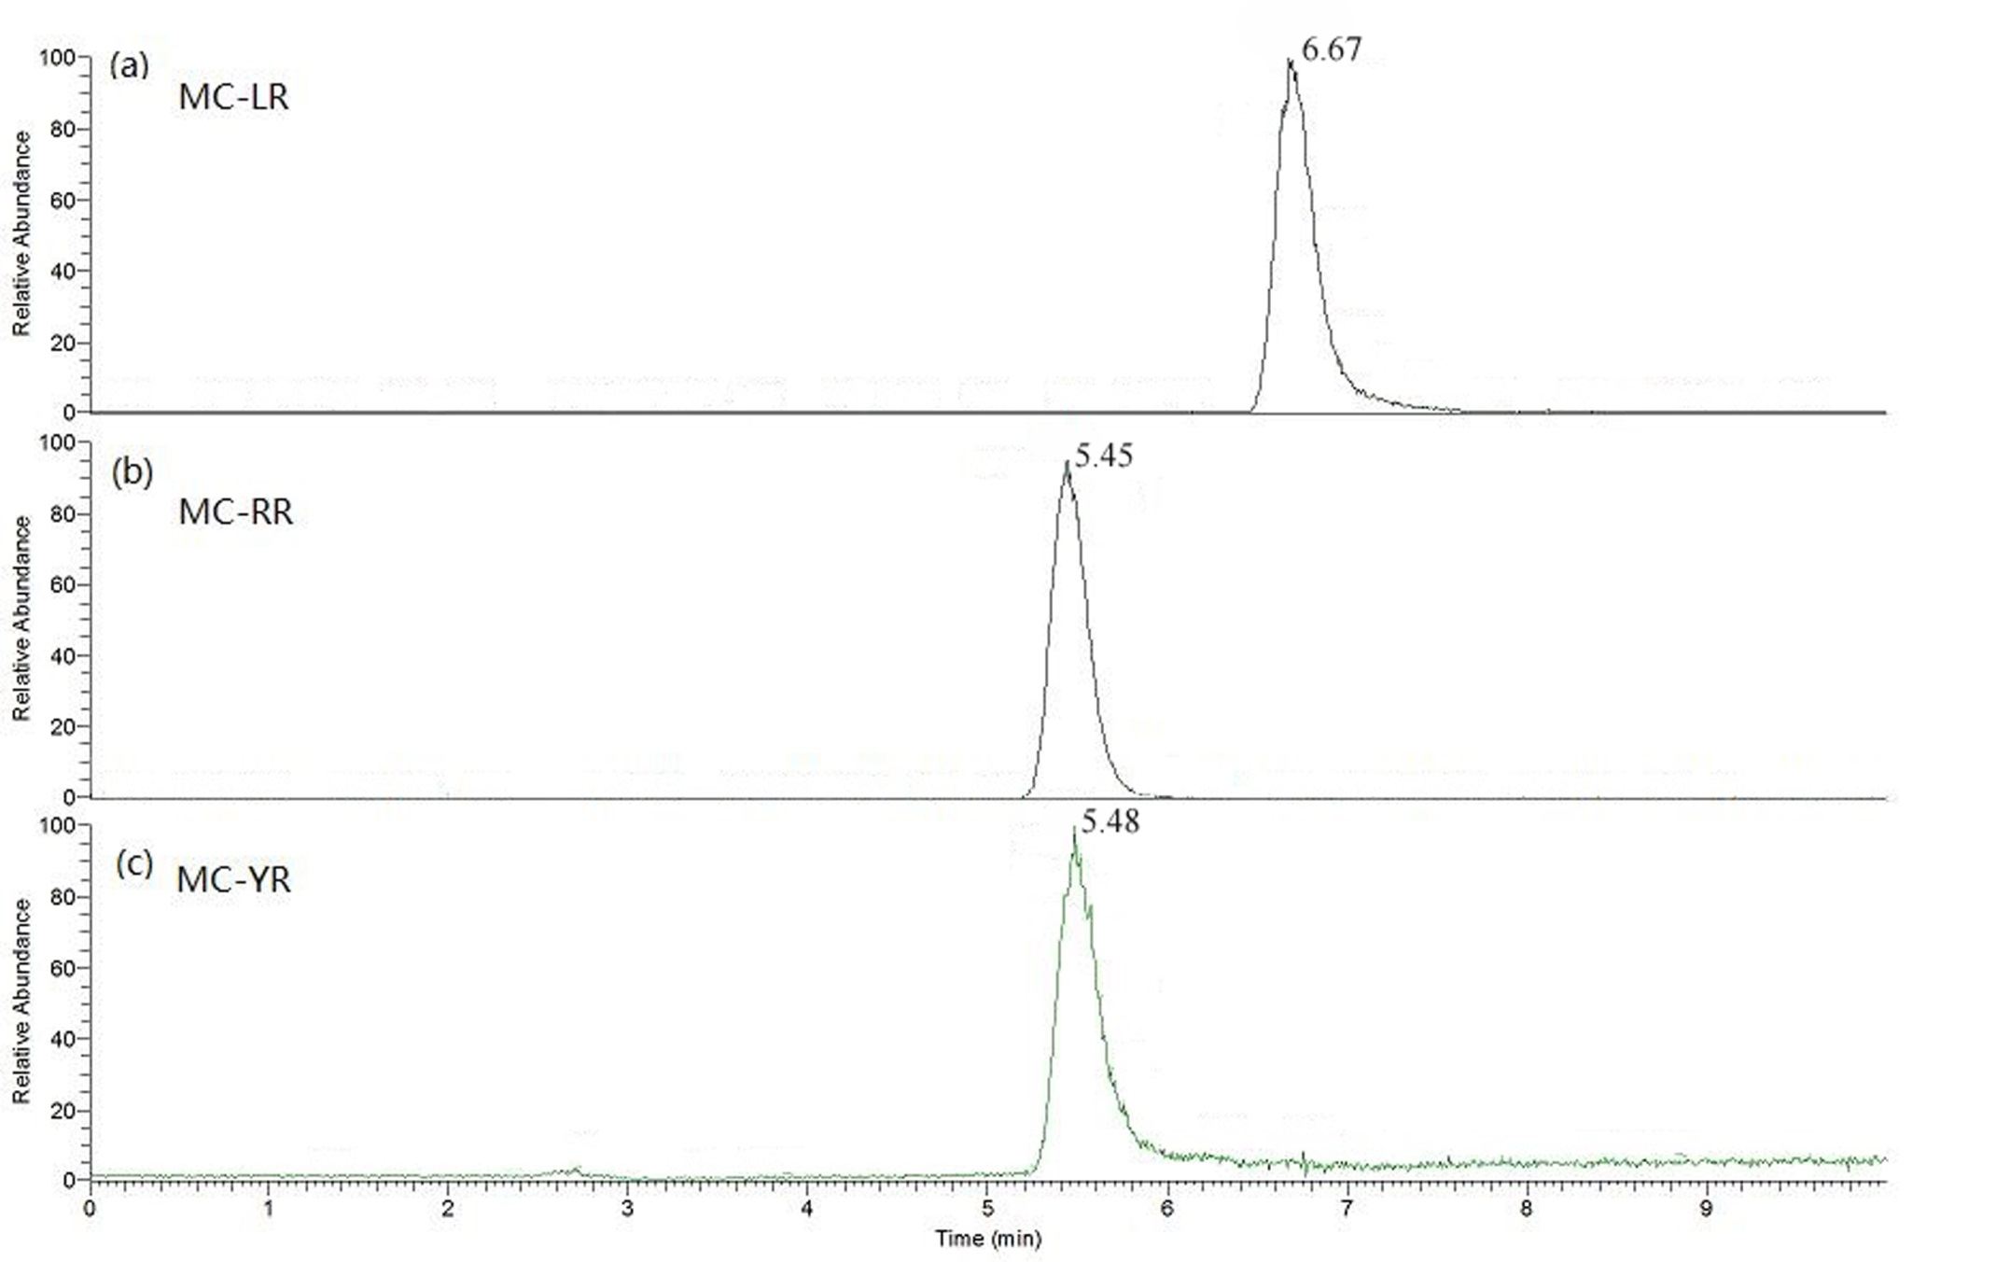
Figure S1. Extracted ion chomatography of microcystin-LR, -RR, YR from the Microcystis sp. YFM1

