Slide 1
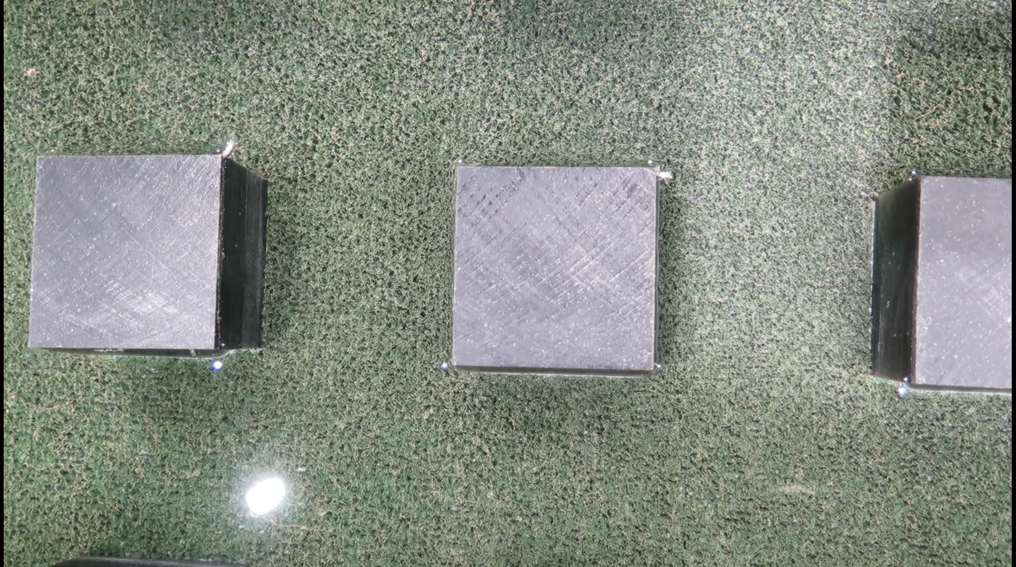
Figure A. Visualization of vortex shedding and transverse oscillating motion of water by pouring saw dust on the water surface (Multimedia view).

