Slide 1
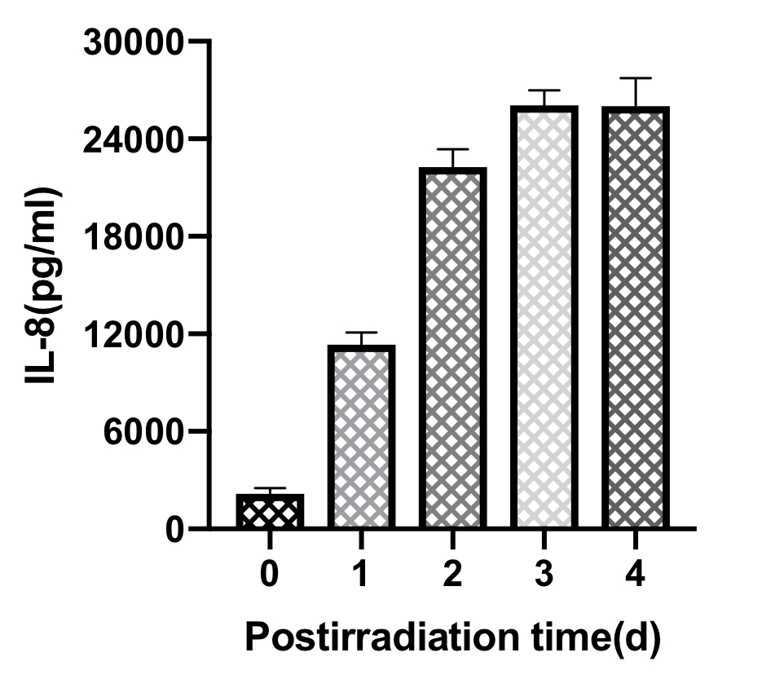
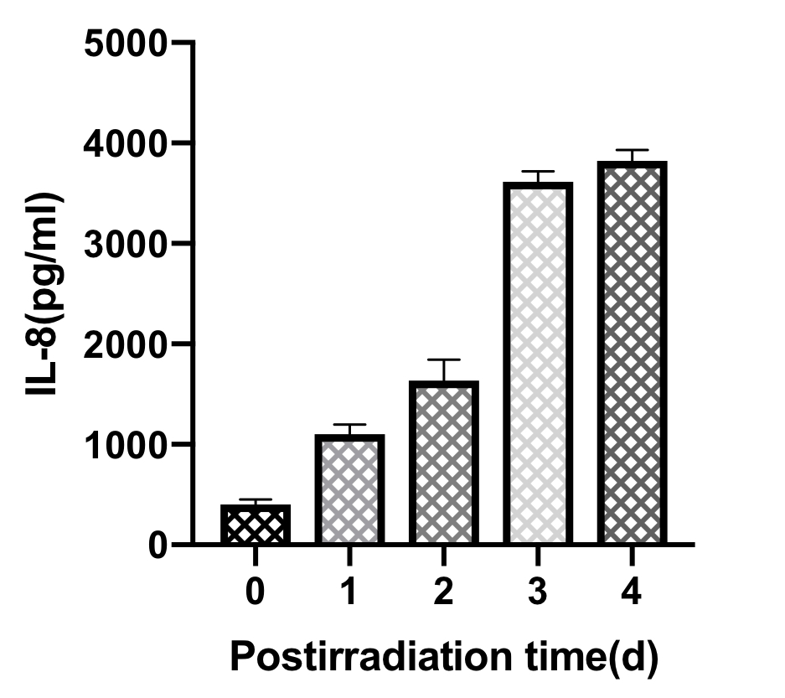
Figure 1
A
B
HUVEC
*
*
THP1
*
*
*
*
*
*

Slide 2
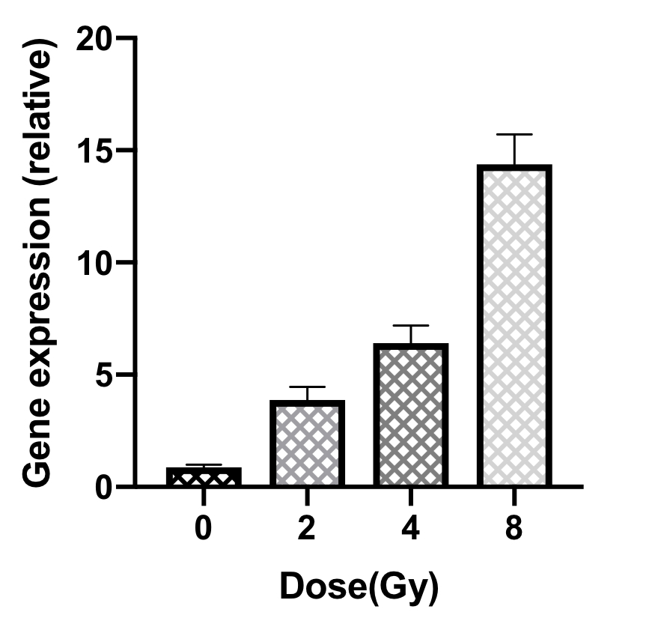
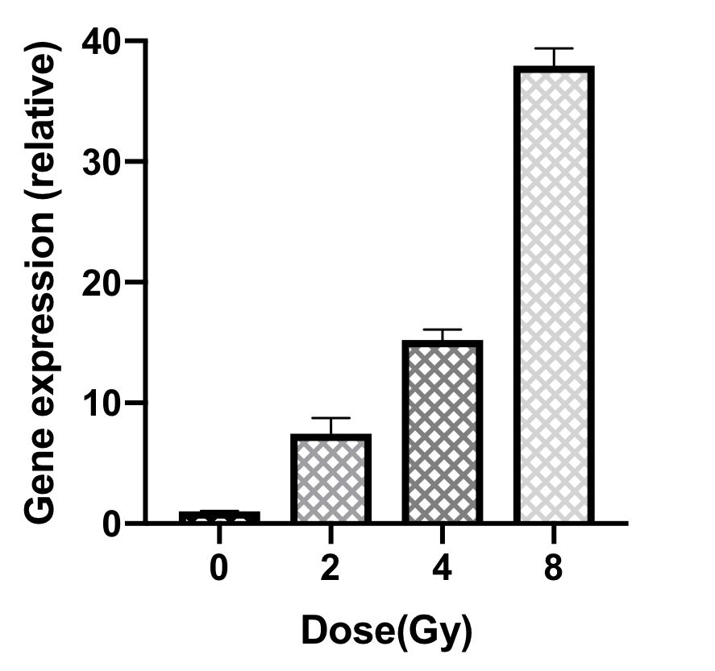
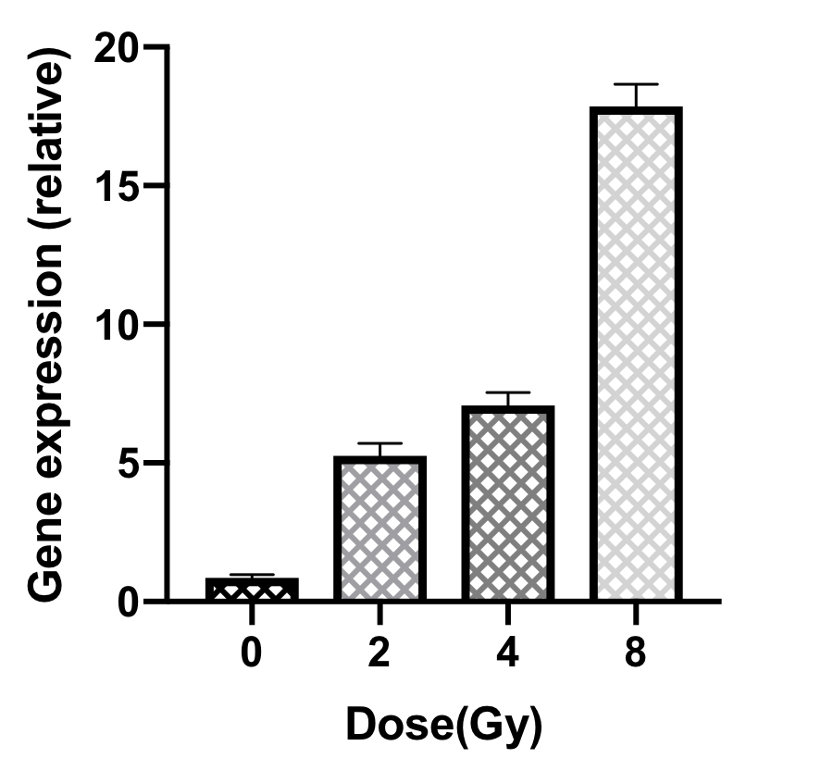
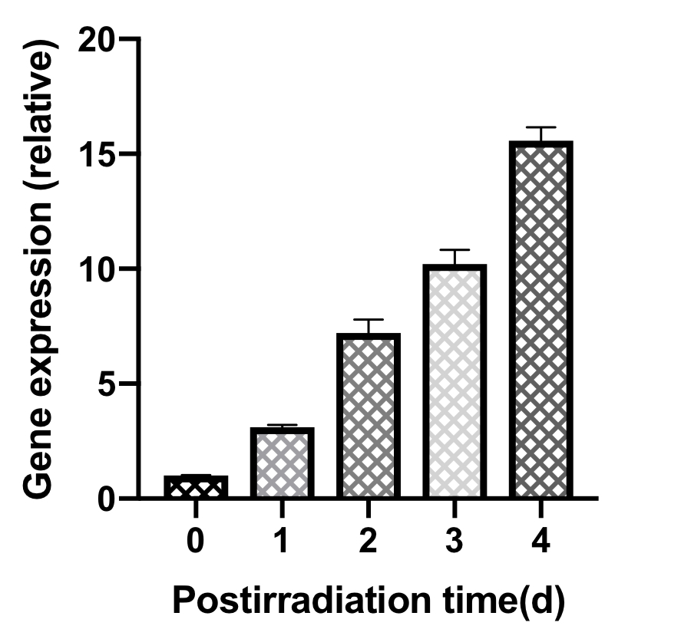
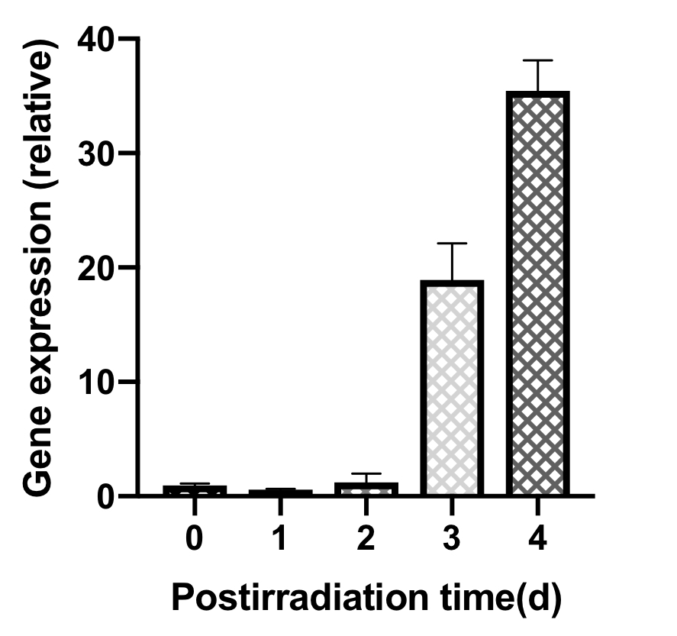
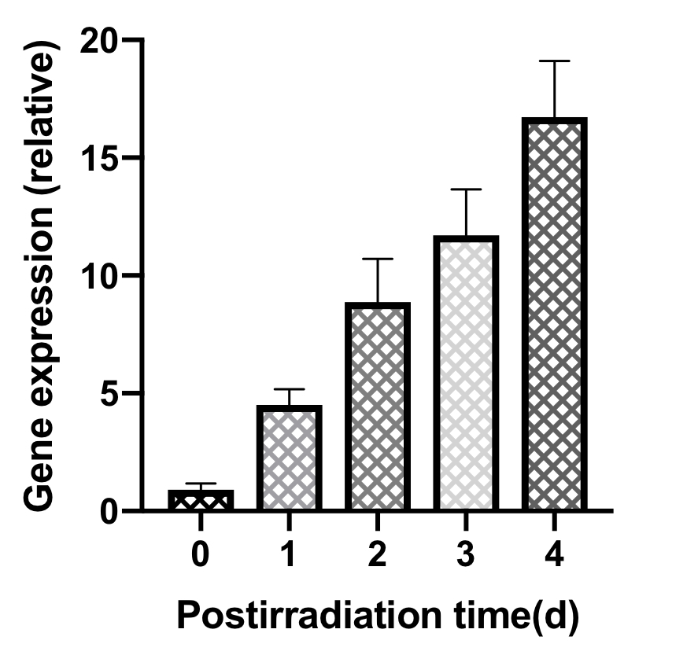
Figure 2
A
B
C
*
*
A549
H446
PC-9
*
*
*
*
*
*
*
D
E
F
*
*
A549
H446
PC-9
*
*
*
*
*
*
*

Slide 3
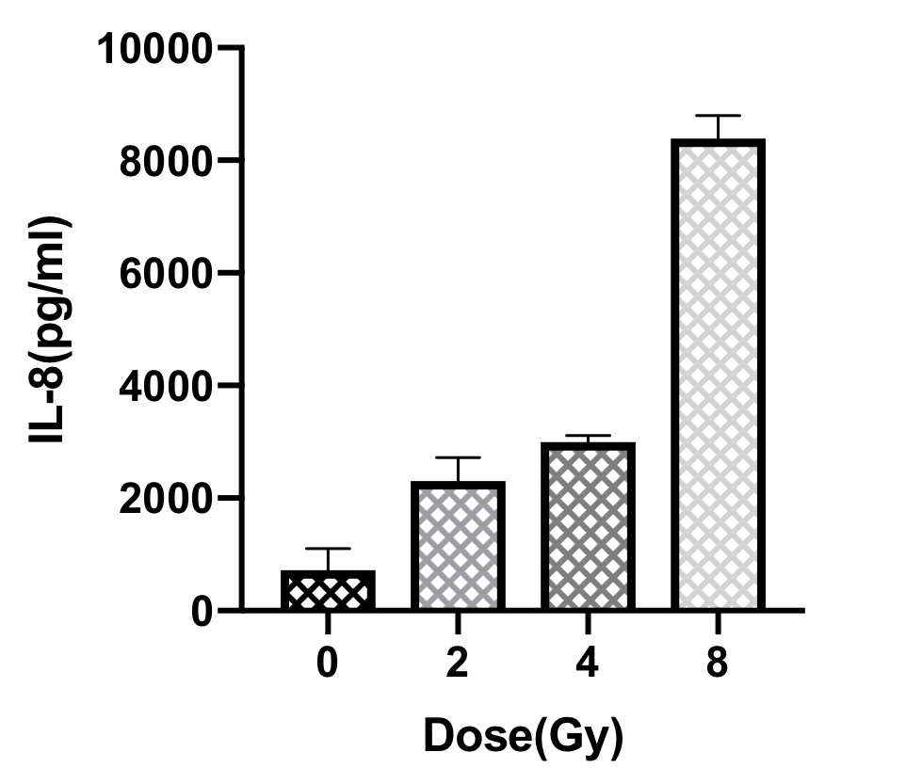
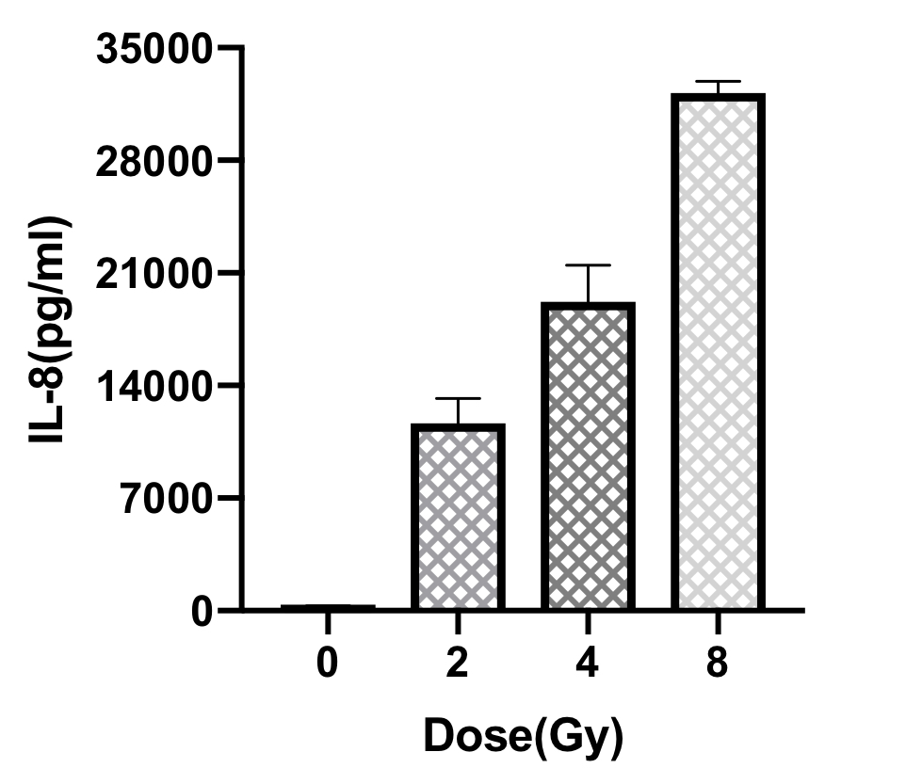
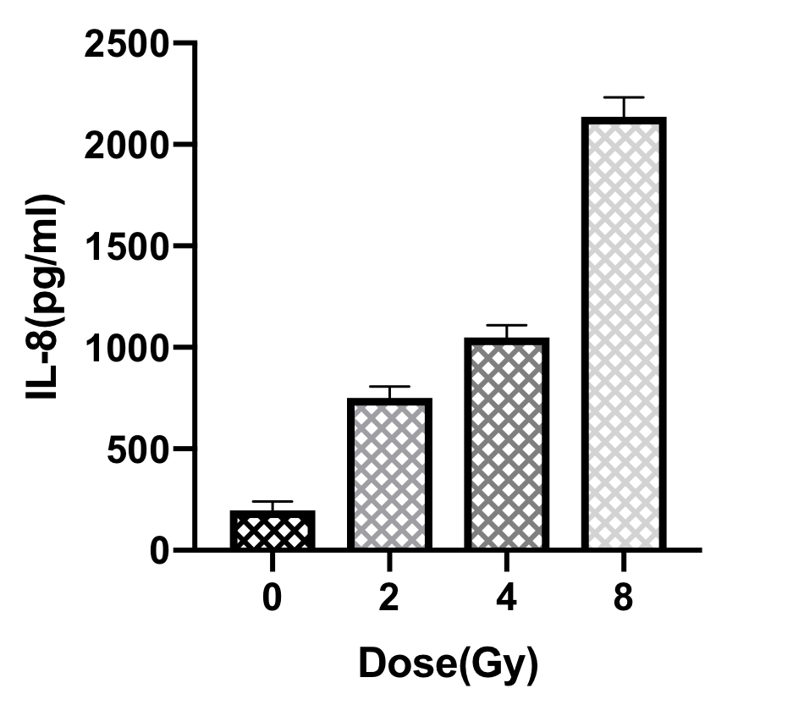
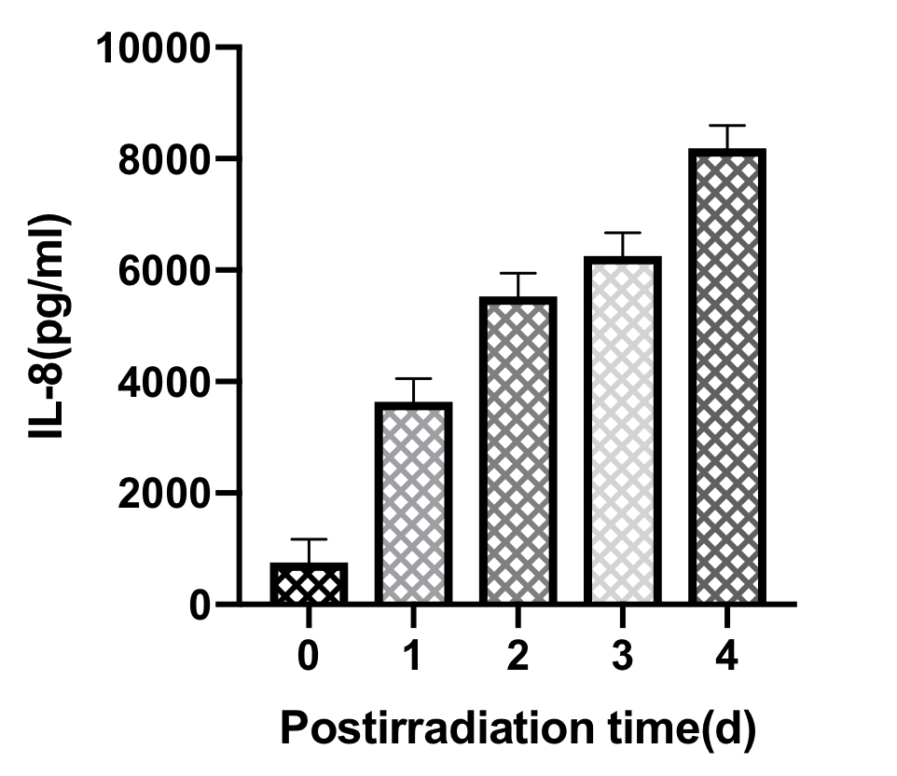
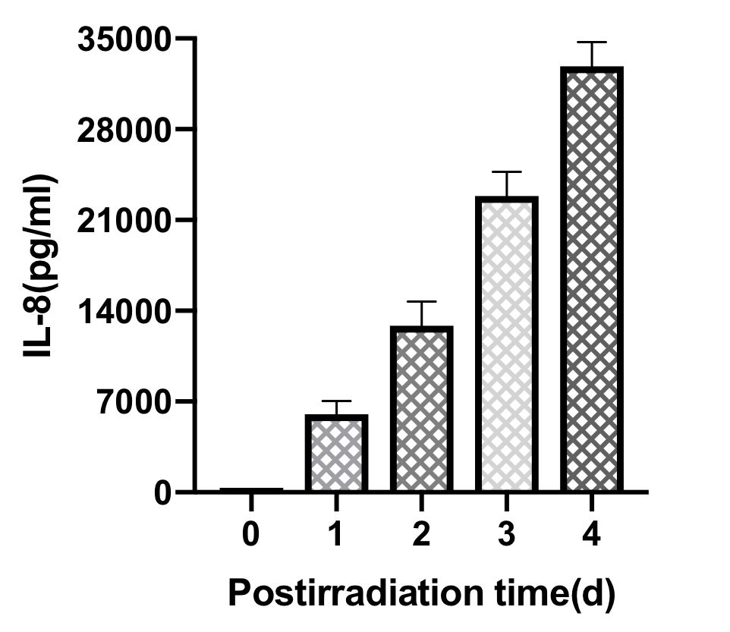
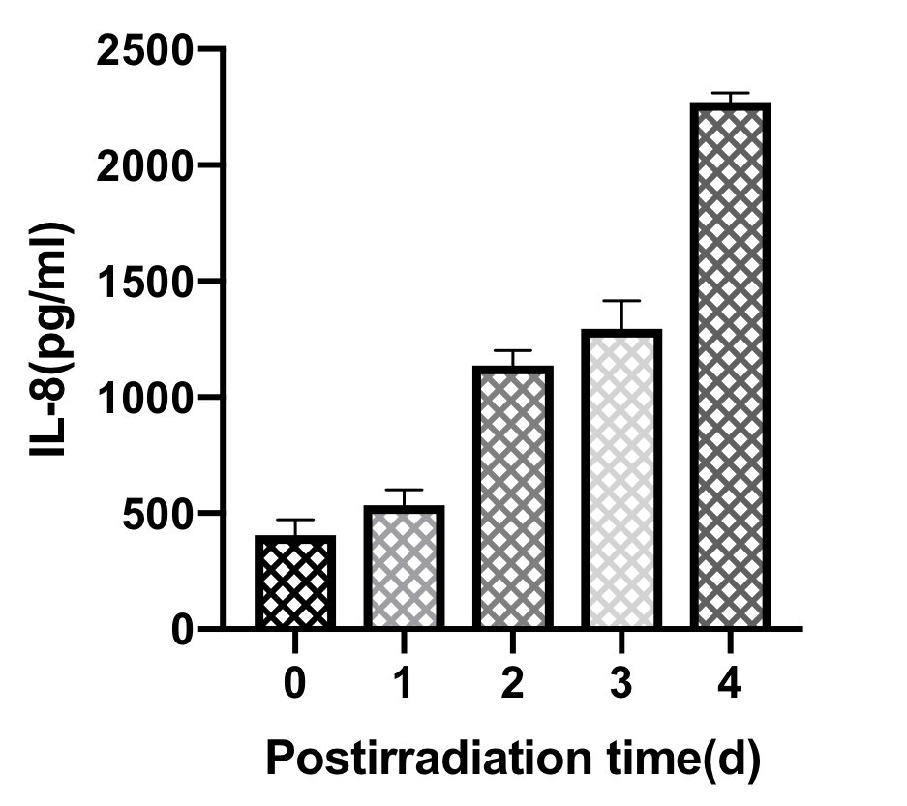
Figure 3
A
B
C
A549
*
H446
*
PC-9
*
*
*
*
*
*
*
D
E
F
*
*
A549
*
H446
PC-9
*
*
*
*
*
*
*
*

Slide 4
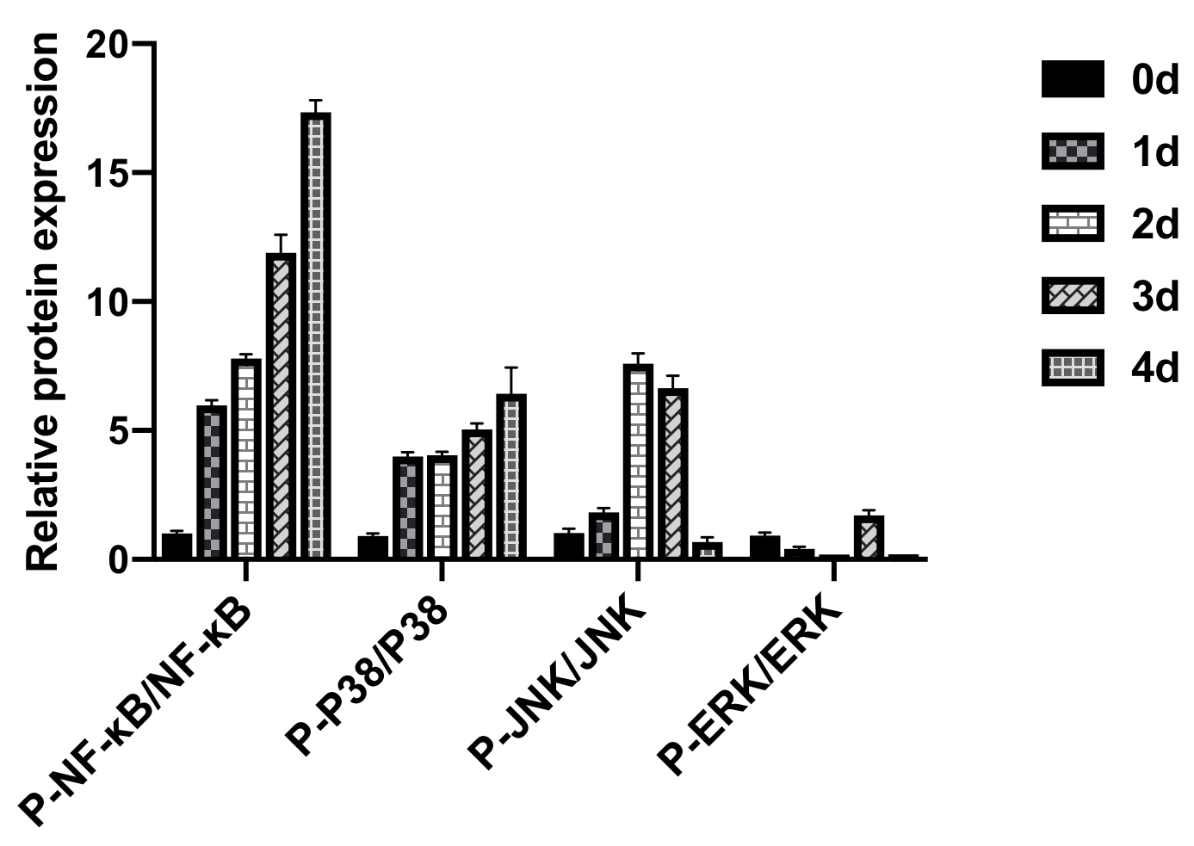
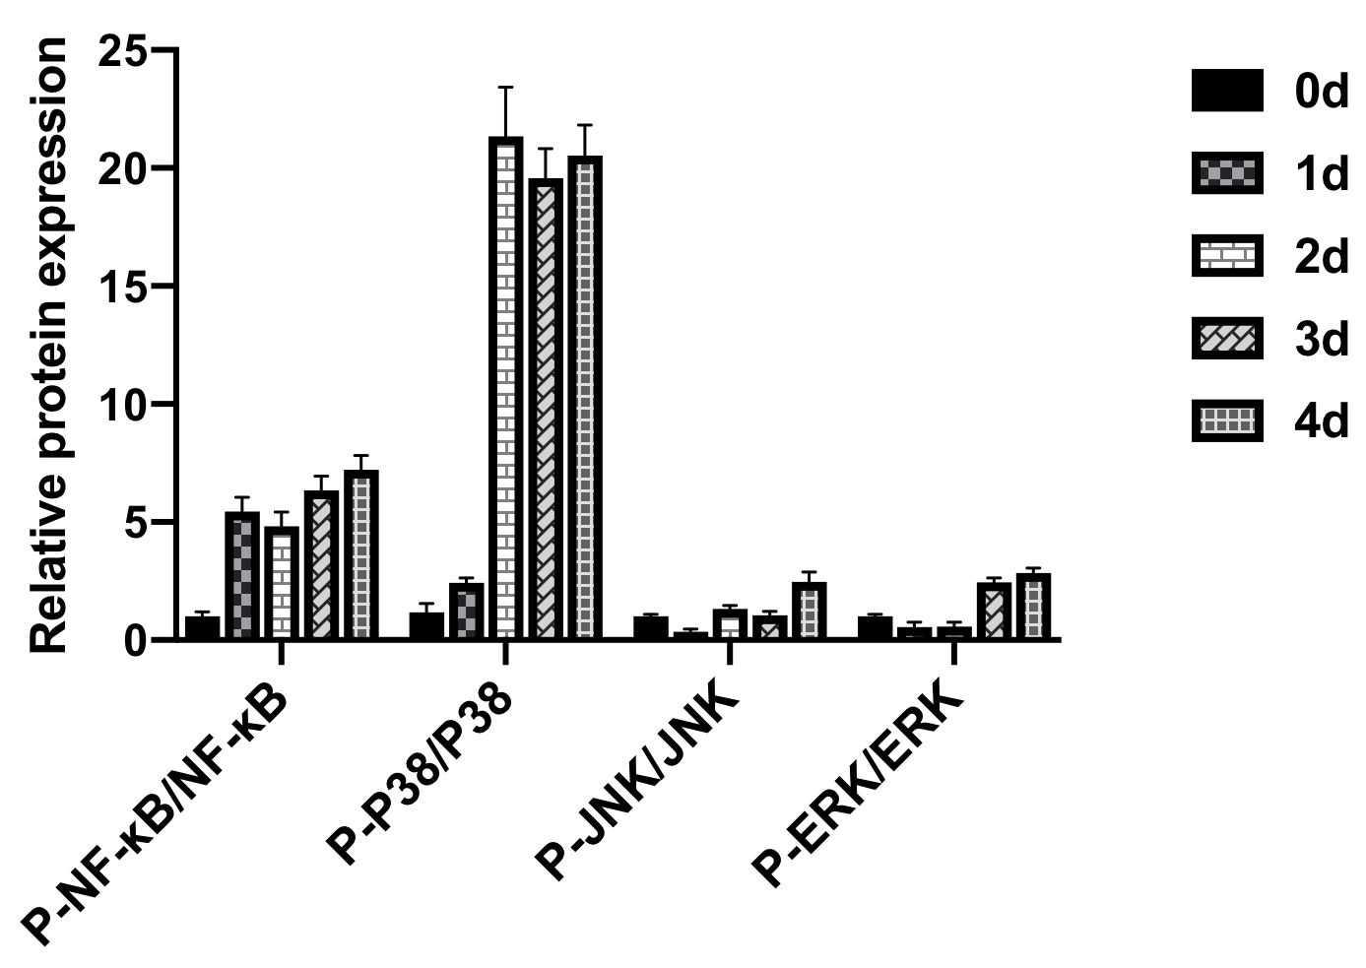
Figure 4
A
B
A549
PC-9
P-NF-κB
P-JNK
P-NF-κB
P-JNK
NF-κB
JNK
NF-κB
JNK
P-P38
P-ERK
P-P38
P-ERK
P38
ERK
P38
ERK
GAPDH
GAPDH
GAPDH
GAPDH
Day
0 1 2 3 4
Day
0 1 2 3 4
Day
0 1 2 3 4
Day
0 1 2 3 4
C
D
A549
PC-9
*
*
*
*
*
*
*
*
*
*
*
*
*
*
*
*
*

Slide 5
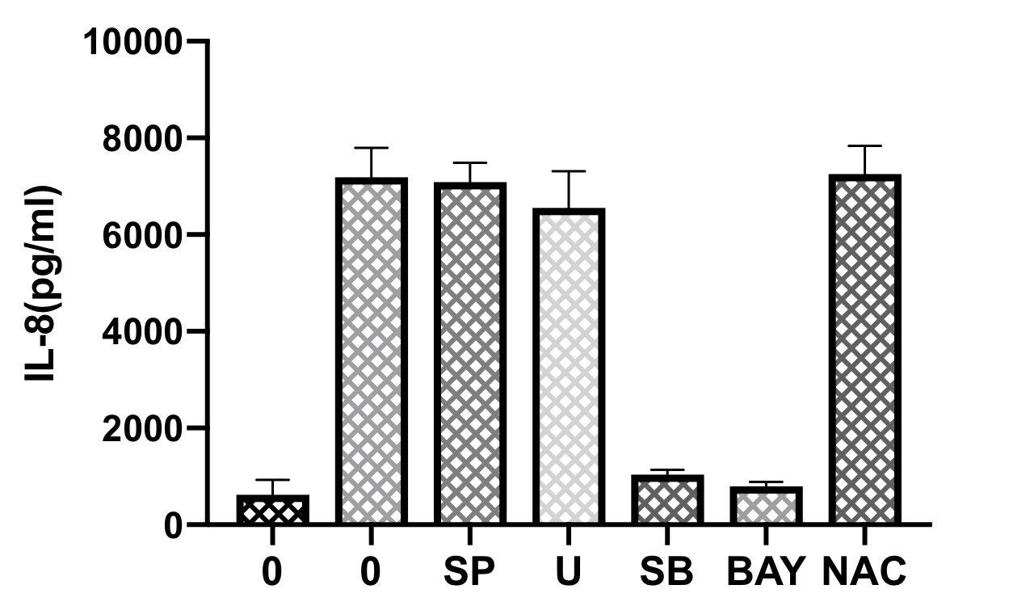
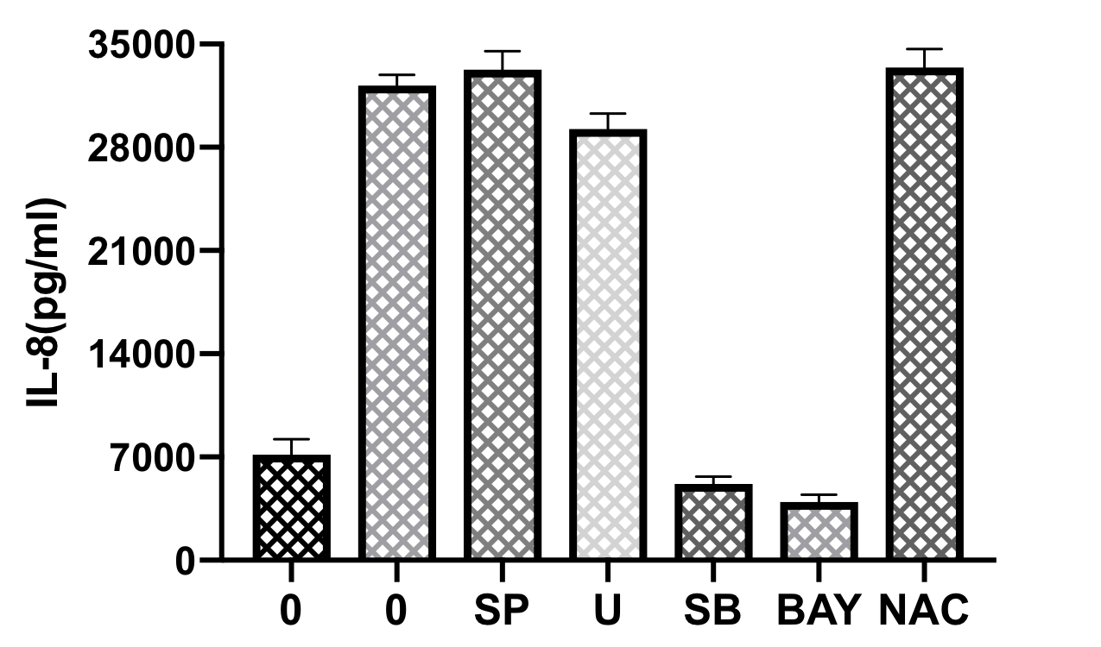
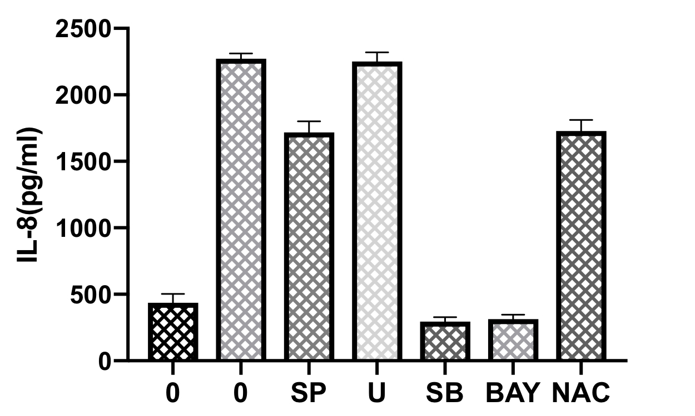
Figure 5
A
B
C
*
*
*
*
*
A549
*
H446
PC-9
Inhibitors
Inhibitors
Inhibitors
Radiation - + + + + + +
Radiation - + + + + + +
Radiation - + + + + + +

Slide 6
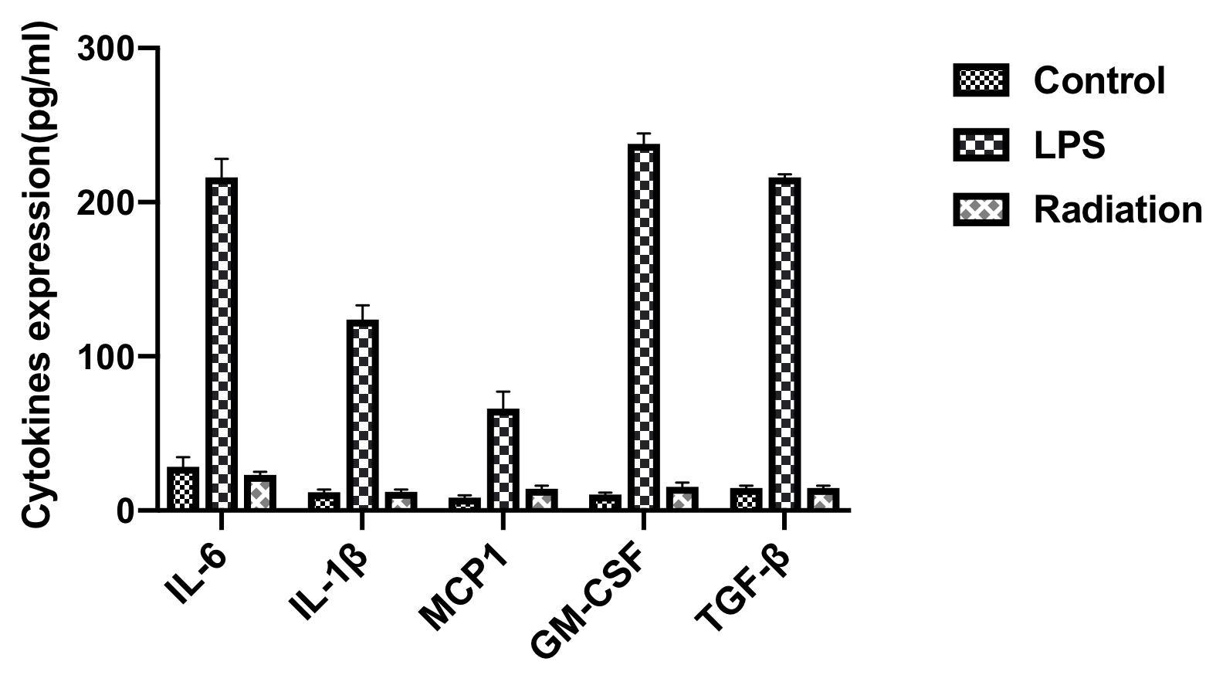
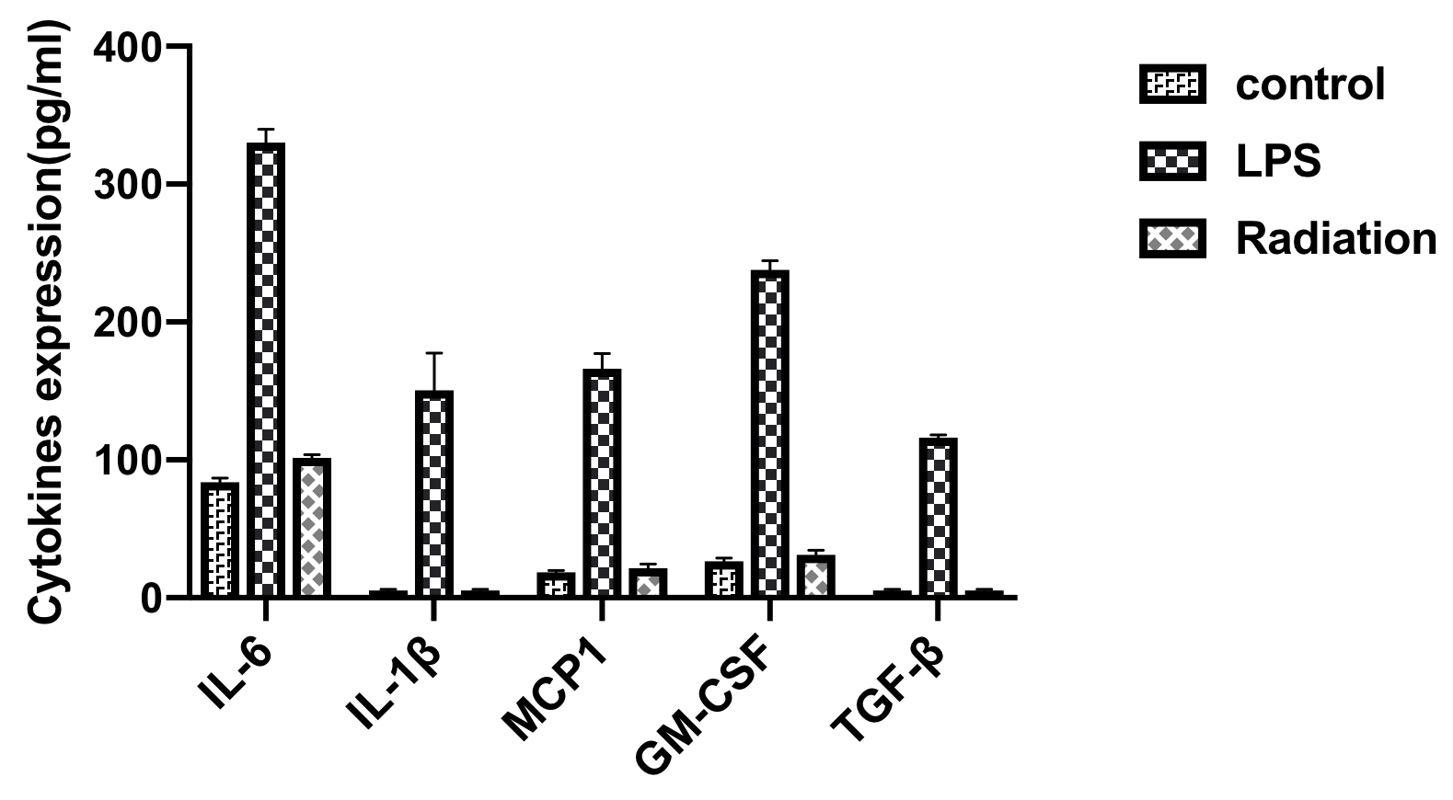
Supplementary figure
A
B
A549
PC-9

Slide 7
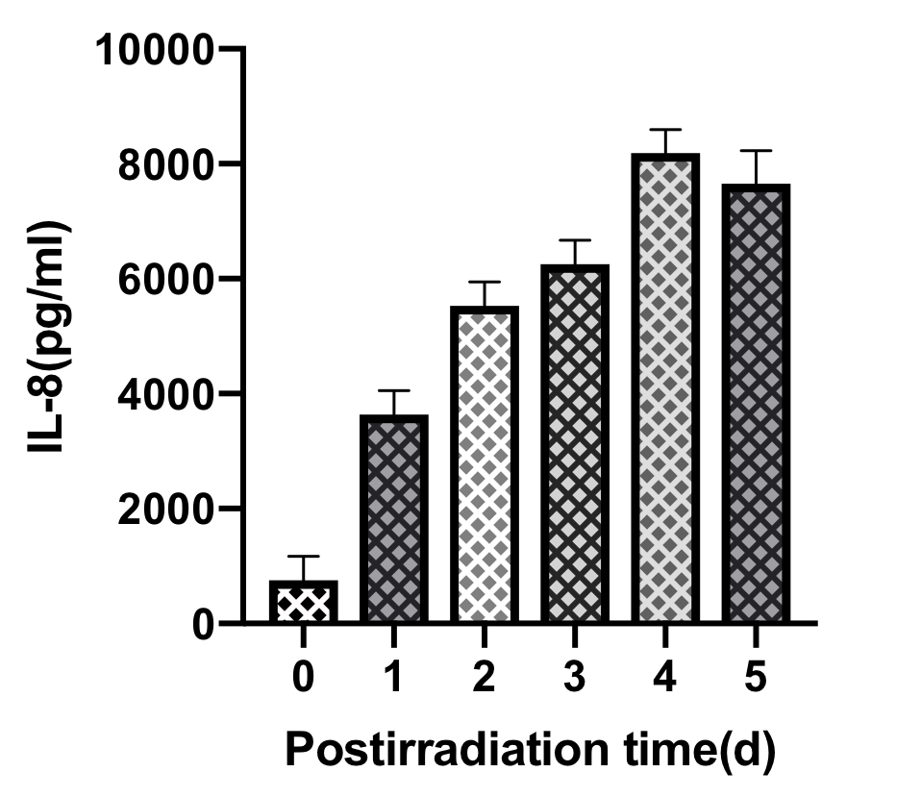
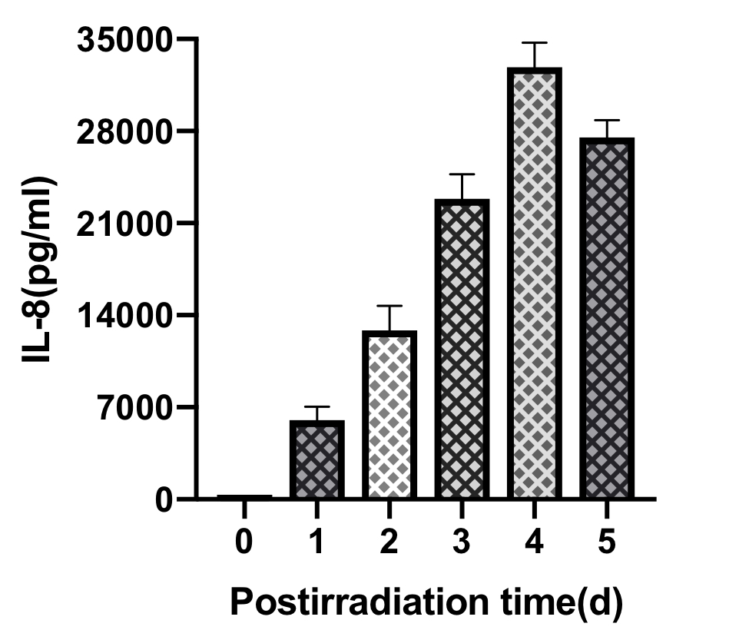
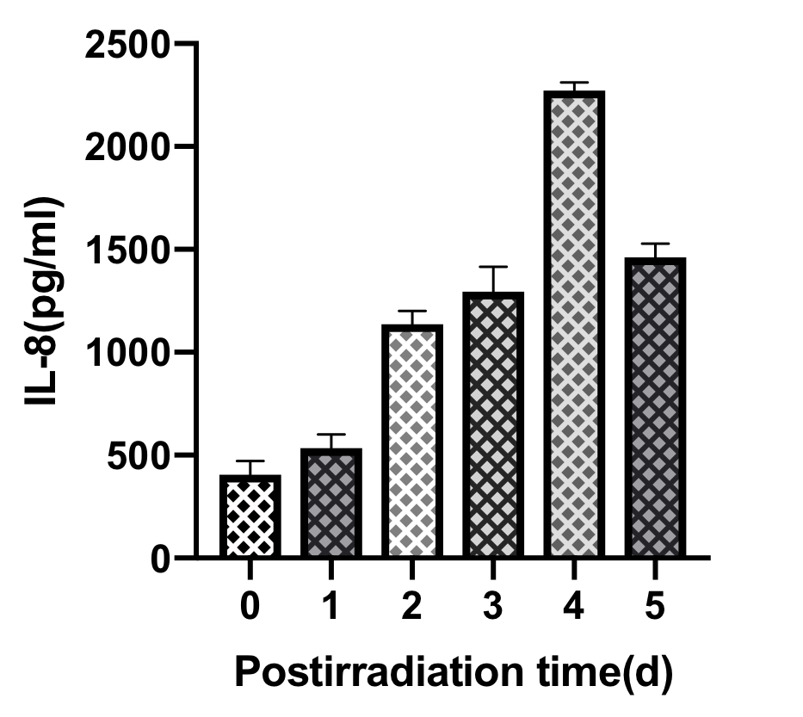
Supplementary figure
A
B
C
A549
H446
PC-9

Slide 8
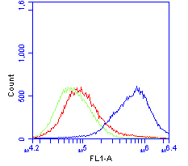
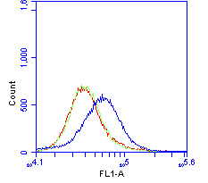
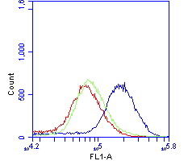
Supplementary figure
A
B
C
A549
H446
PC-9
Control
Radiation
NAC

