Slide 1
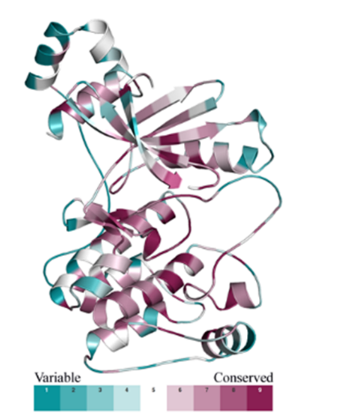
Figure S1:Representation of Evolutionary Conservation Analysis. Dark violet regions correspond to highly conserved, whereas dark cyan region shows variable residues of the MARK4.

Slide 2
Figure S2:Hydrogen bond patterns of MARK4 WT and mutants A) Hydrogen bond plot of WT B) Hydrogen bond plot of Lys231Asn. C) Hydrogen bond plot of Tyr247His. D) Hydrogen bond plot of Arg265Gln

Slide 3
Figure S3: Secondary Structure element distribution plots of MARK4 WT(A), Lys231Asn(B), Tyr247His(C) , and Arg265Gln(D).

Slide 4
Figure S4: Solvent Accessible Surface Area plots of MARK4 WT and Mutants (A-D)

Slide 5
Figure S5: Residue wise loading plots of PCs of WT (A), Lys231Asn(B), Tyr247His(C), and Arg265Gln(D)

