Slide 1
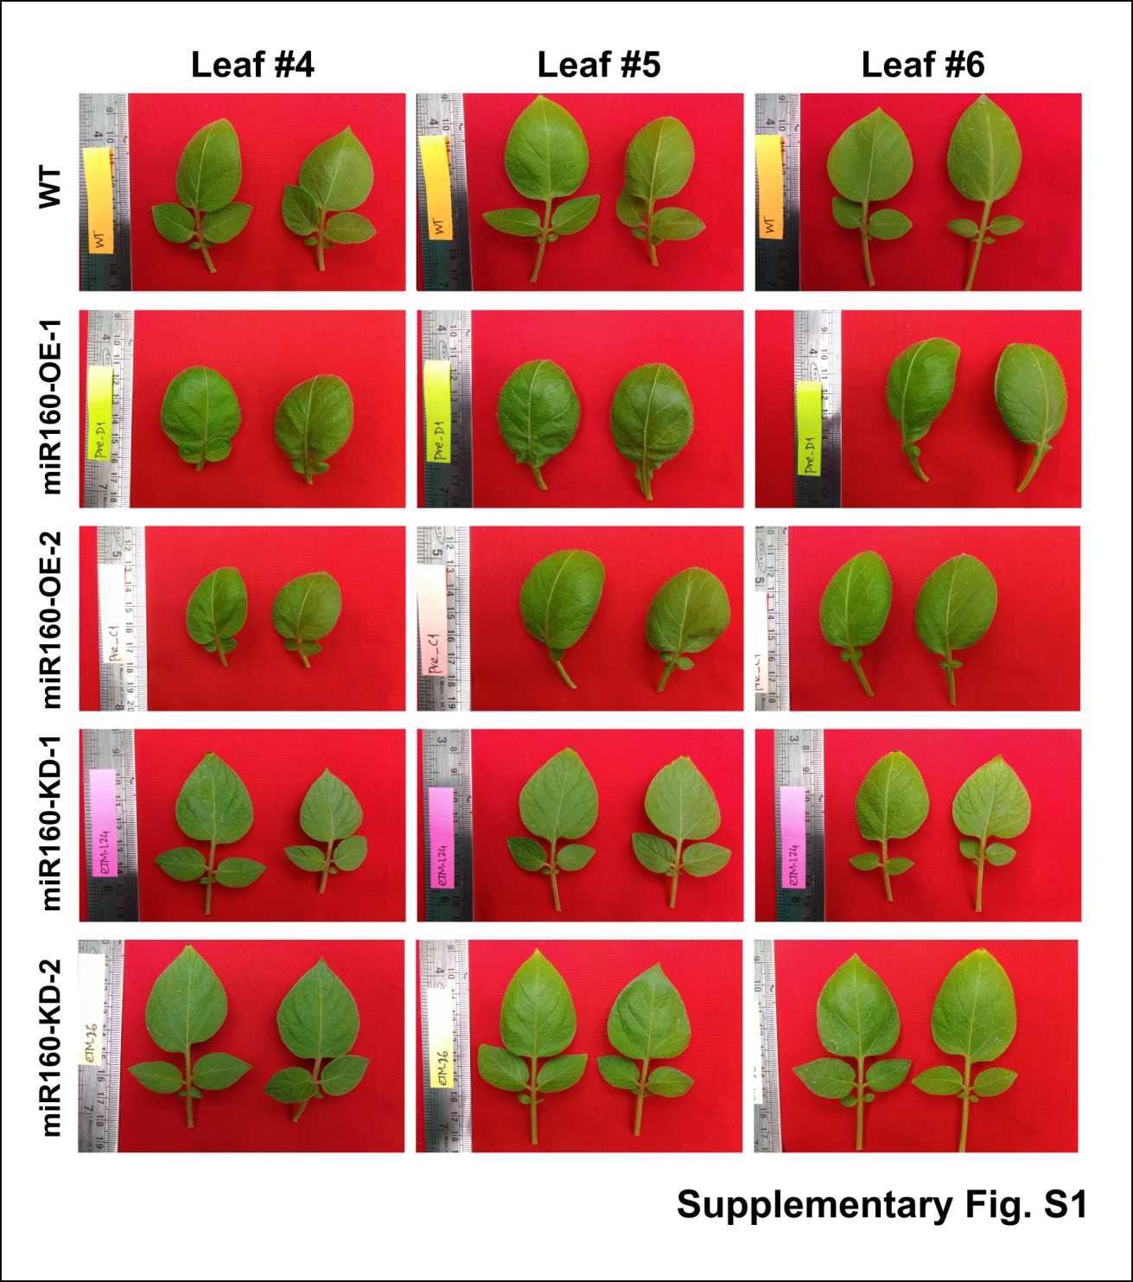
Supplementary Fig.S1 Photographs of leaves from WT and two independent transgenic lines each of miR160-OE and miR160-KD plants. For each plant type representative leaves emerging from nodes 4, 5 and 6 (counting from top of the plant) are shown here. Downward curved leaf phenotype can be observed in the leaves from both the miR160-OE transgenic plants. White arrows indicated the presence of small lateral leaves and supression of leaf compounding.

Slide 2
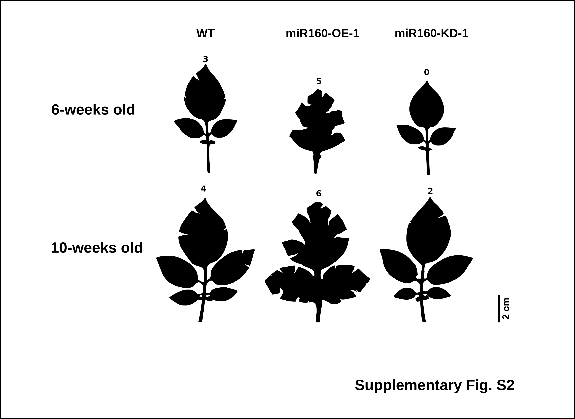
Supplementary Fig.S2 Comparison the leaf features with increasing leaf age. Slihouttes of leaves from 6-weeks (young, 5th leaf) and 10-weeks (oldest leaf) old plants. The numerals on top of each leaf are the number of cuts required to flatten the terminal leaf. miR160-OE-1 leaf requires more cuts and miR160-KD-1 requires less cuts than wildtype (WT) both in young and old leaves.

Slide 3
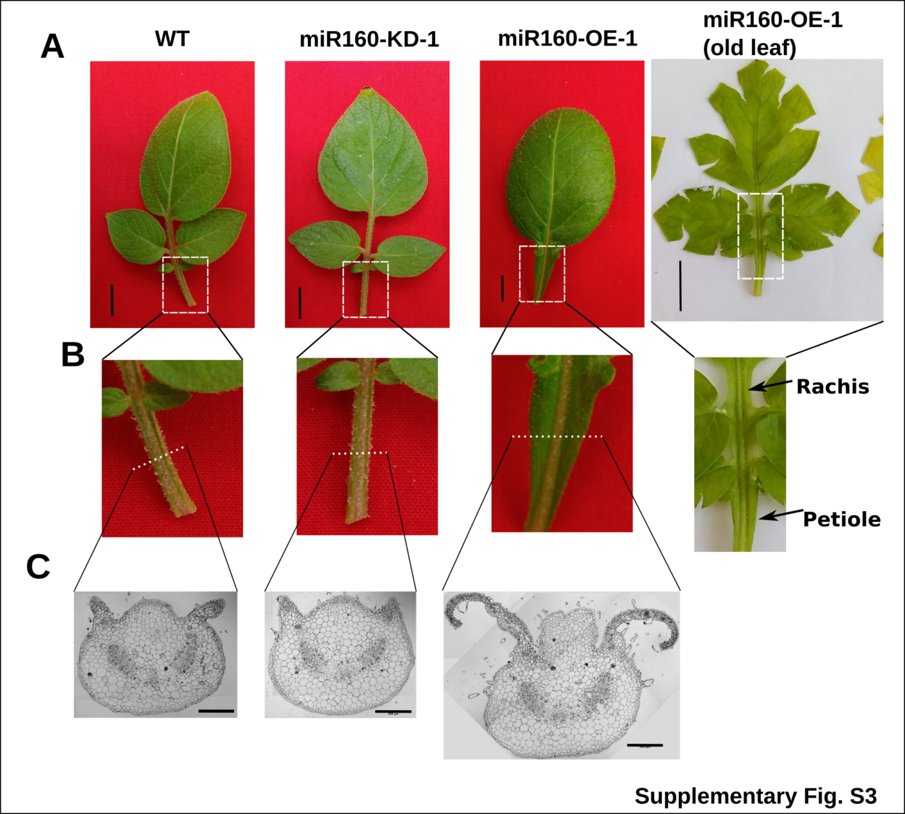
Supplementary Fig.S3 Excess blade growth is observed on the rachis and petioles of miR160-OE-1 leaves. (A-B) Photographs of WT, miR160-KD-1 and miR160-OE-1 (young and old) leaves (A) and close up of their rachis and petiole (B). (C) Histological sections of petioles from WT, miR160-KD-1 and miR160-OE-1 leaves clearly shows excess blade development in miR160-OE-1 leaves.
Scale: 2 cm in A and 300 µm in C.

