Slide 1
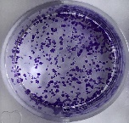
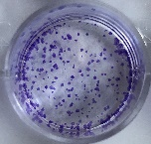
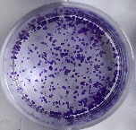
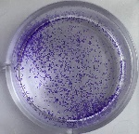
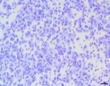
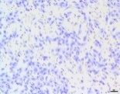
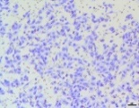
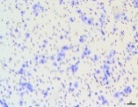
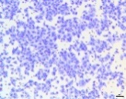
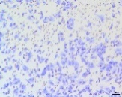
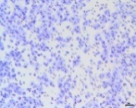
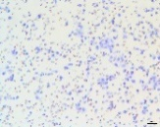
Supplementary Figure 1
(A)
(B)
Relative miR-511-3p
expression
miR-NC
miR-NC
20
SW620
Colo205
2.0
miR-511-3p mimic
2.0
miR-511-3p mimic
15
**
1.5
OD 450 values
OD 450 values
**
1.5
**
10
1.0
1.0
*
5
0.5
0.5
0
miR-NC
0
0h
12h
24h
48h
72h
0
0h
12h
24h
48h
72h
miR-NC
miR-511-3p mimic
SW620
Colo205
miR-511-3p mimic
(C)
250
SW620
250
Colo205
SW620
200
200
150
150
Colony number
**
Colony number
100
100
**
colo205
50
50
0
0
miR-NC
miR-511-3p mimic
miR-NC
miR-NC
miR-511-3p mimic
miR-511-3p mimic
(D)
miR-NC
miR-511-3p mimic
miR-NC
Migration
300
miR-511-3p mimic
200
Invasion
100
**
**
0
Migration
Invasion
(E)
SW620
miR-NC
miR-511-3p mimic
miR-NC
Migration
250
miR-511-3p mimic
200
150
100
**
**
Invasion
50
0
Migration
Invasion
Colo205

