Slide 1
SUPPLEMENTARY FIGURES AND TABLES for:
Loss of KMT2C reprograms the epigenomic landscape in hPSCs resulting in NODAL overexpression and a failure of hemogenic endothelium specification.
Shailendra S. Maurya¹, Wei Yang², Minori Tamai¹, Qiang Zhang³, Petra Erdmann-Gilmore³, Amelia Bystry¹, Fernanda Martins Rodrigues³, Mark C. Valentine¹, Wing Hing Wong¹, Reid Townsend³, Todd E. Druley^{1*}
¹ Department of Pediatrics, Division of Pediatric Hematology and Oncology,
² McDonnell Genome Institute, Genome Technology Access Center,
³ Department of Internal Medicine,
Washington University School of Medicine, 660 South Euclid Avenue, St. Louis, Missouri USA 63108

Slide 2
Supplementary Figure 1. A) schematic representation of the Cas9-mediated nonsense mutation introduced at exon 3 of 52 (arrow) in the protein sequence of KMT2C. B) CRISPR-mediated knockout of KMT2C in hiPSCs and C) H1 ESCs, which D) is specific to KMT2C compared to its paralogs.

Slide 3
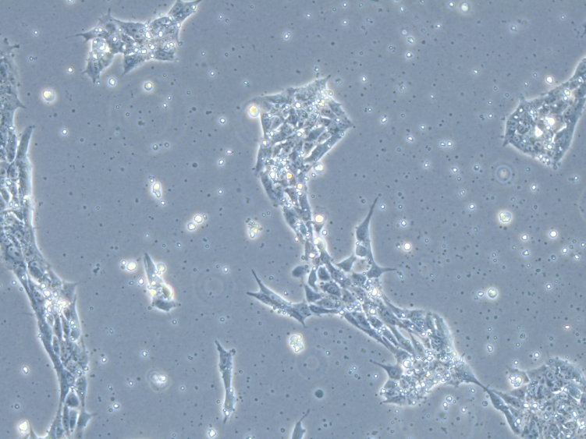
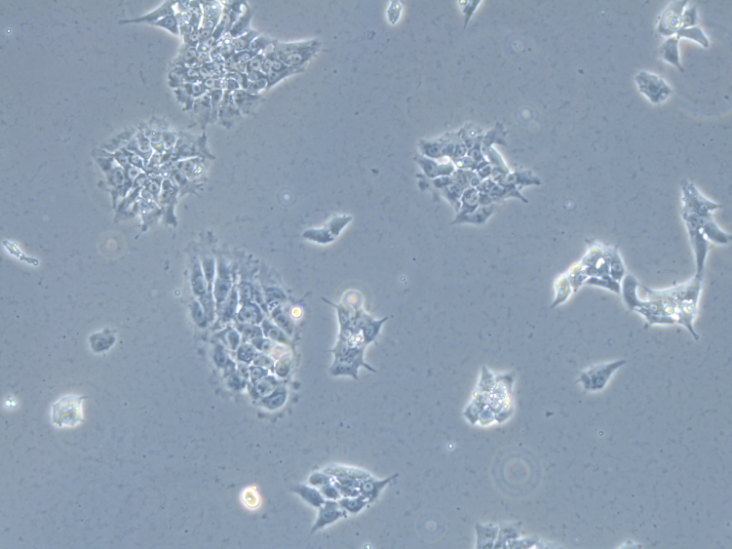
Supplementary Figure 2. WT and KMT2CKO hiPSCs are morphologically similar and stain similarly in pluripotency. Cell culture conditions were followed as described by Sturgeon C et al., Nature Biotech 2014. A) Light microscopic images of human pluripotent cells in culture on day 2 (10X magnification) and day 5 (40X magnification). Cell demonstrate similar morphology. B, C) Confluent monolayers of wild type (Panel B) or KMT2CKO (Panel C) human pluripotent cells were stained using the Embryonic Stem Cell Marker Panel (Abcam, cat# ab109884: Human: Oct4, Nanog, SOX2) as well as Hoechst (Abcam, cat# ab228551) for cell nuclear staining. After being stained for 48 hours, images were collected using a Leica DMI8 fluorescent microscope at 20X magnification (λ = 448). Overlaid images demonstrate that the majority of cells were positive for all three stains, consistent with a pluripotent state.
A.
10X, day 2
40X, day 5
WILD TYPE
KMT2CKO

Slide 4
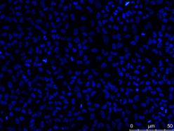
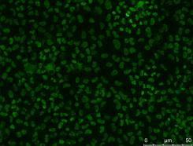
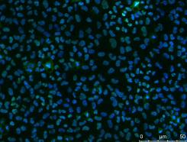
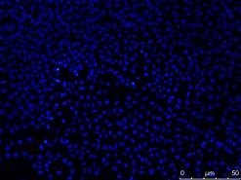
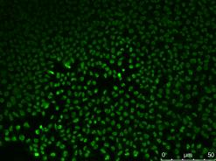
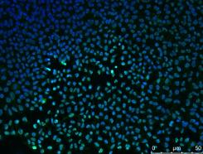
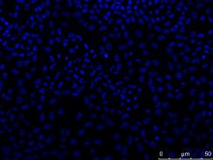
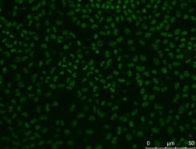
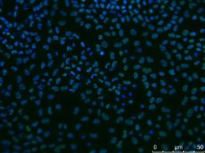
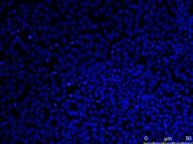
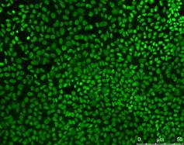
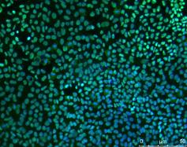
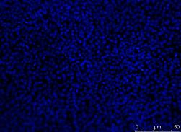
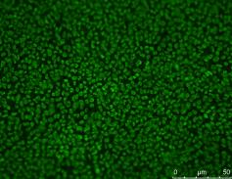
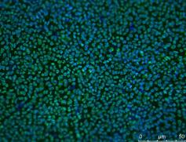
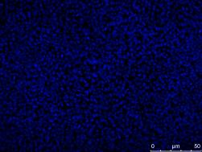
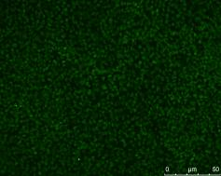
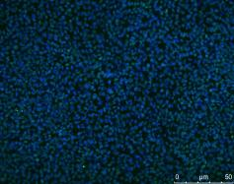
Supplementary Figure 2 – continued.
B.
Hoechst
Overlay
SOX2
OCT4
WILD TYPE hiPSC
NANOG
C.
Hoechst
Overlay
SOX2
OCT4
KMT2CKO hiPSC
NANOG

Slide 5
Supplementary Figure 3. KMT2CKO teratoma assay confirms pluripotency
Washington University Division of Comparative Medicine veterinary pathology report:
KMT2CKO teratoma report: Examples of tissues of endodermal origin included pseudostratified columnar epithelium with goblet cells and simple cuboidal epithelium. Tissues of mesodermal origin included cartilage, bone, smooth muscle, loose connective tissue, and eosinophils (likely of murine origin). Examples of tissues of ectodermal origin included embryonal brain, peripheral nerve, and cells presumed to be melanocytes.
Endoderm
Pseudostratified columnar epithelium
Mesoderm
Unmineralized bone
Ectoderm
CNS and Melanocytes

Slide 6
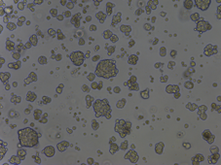
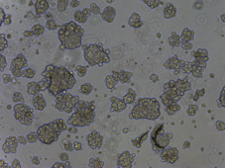
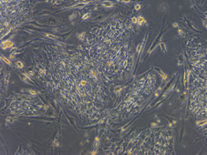
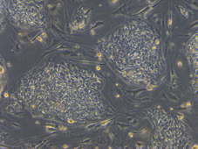
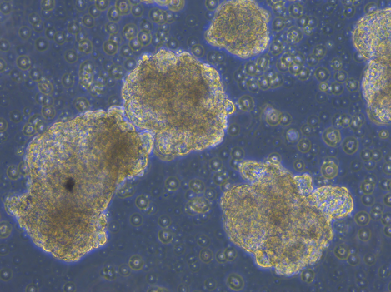
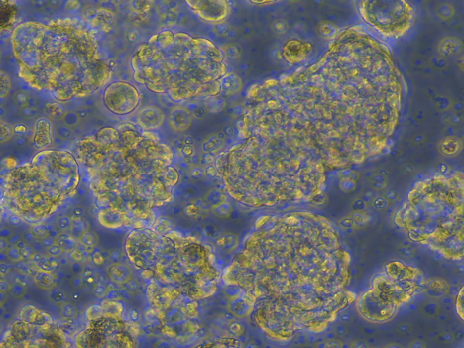
Supplementary Figure 4. Comparison of culture days 3-8 of directed definitive hematopoietic differentiation in H1 ESCs. Transduction was done by the Washington University Genome Engineering and iPS Core using a guide RNA (gRNA) to exon 3 of KMT2C or a scrambled gRNA control. Culture conditions per Sturgeon C et al. Nat Biotech 2014. Images taken via light microscopy at 10X magnification on the days in culture listed. Both cell lines formed embryoid bodies by day 8 with similar morphology.
H1 ESC Wild-type
(Scrambled gRNA transduction)
H1 ESC KMT2CKO
(Transduced with KMT2C KO gRNA)
Day 3
Day 3
Day 5
Day 5
Day 8
Day 8

Slide 7
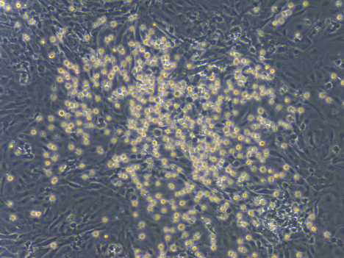
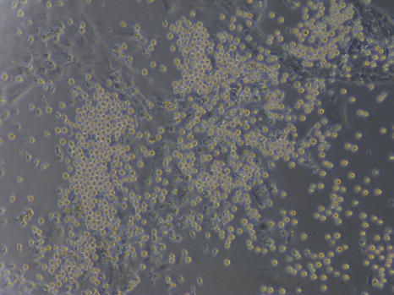
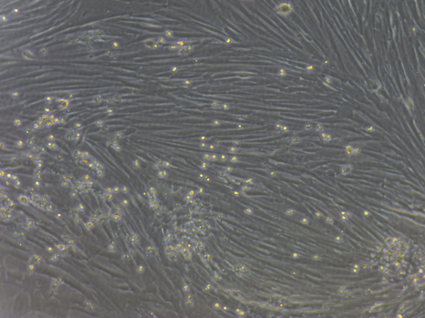
Supplementary Figure 5. Disturbed hematopoietic to endothelial transition in KMT2CKO H1 ESCs. The same H1 ESCs shown in Supp Figure 4 remained in culture according to the published protocol by Sturgeon C et al. Nature Biotech 2014. As reported in that manuscript, wild type pluripotent cells with a mesodermal immunophenotype (KDR+ CD235a-) treated with a WNT agonist proceed to a hemogenic endothelial immunophenotype (CD73- CD184-) and are visualized in culture by losing their need for contact dependence, floating freely in culture. Cells remaining adhered to the culture dish have an immunophenotype of either arterial endothelium (CD73mid CD184+) or venous endothelium (CD73+ CD184-). Note that all three subtypes of endothelium are derived from CD34+ CD43- cells.
H1 ESC Wild-type
(No vector transduction)
After 9 days in culture and 7 days exposure to WNT agonist, hemogenic endothelium is formed and observed via light microscopy as free-floating bright round cells. See Figure 1.
H1 ESC Wild-type
(Scrambled gRNA transduction)
Cells transduced with a scrambled guide RNA, expressing KMT2C and treated in culture as described above, demonstrate the same free-floating hemogenic endothelial cells in vitro. These results demonstrate that the transduction itself did not cause the lack of hemogenic endothelium observed in the KMT2CKO H1 ESC line.
H1 ESC KMT2CKO
(Transduced with KMT2C KO gRNA)
Cells transduced with a guide RNA targeted to exon 3 of KMT2C and lacking KMT2C mRNA or protein expression demonstrate a marked reduction in free-floating cells with a CD73- CD184- immunophenotype. See Figure 1.

Slide 8
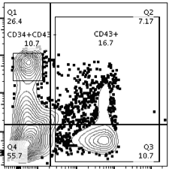
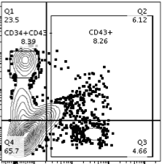
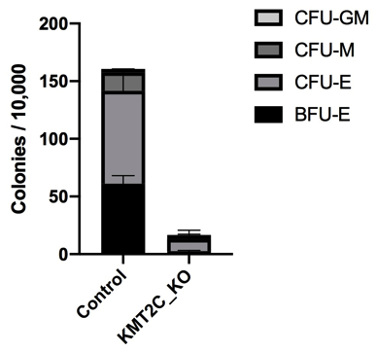
Supplementary Figure 6. KMT2CKO results in reduced primitive hematopoietic colony formation. As shown by Sturgeon C et al. Nature Biotech 2014, when pluripotent cells are treated with a WNT inhibitor (rather than a WNT agonist as described above in Supp Figure 5), ACTIVIN is highly expressed. The resulting cells specify a mesodermal phenotype (KDR+ CD235a+) on day 3 of differentiation. The cells then gain CD34 expression and finally specify a CD34+ CD43- immunophenotype consistent with primitive hematopoietic progenitors only capable of specifying erythroid or myeloid lineages (contrary to definitive hematopoiesis that can also specify T-lymphocytes in culture.
Panel A) KMT2CKO cells demonstrate a reduced number of CD34+ CD43- cells by flow cytometry compared to wild type.
Panel B) Colony forming assays from the resulting CD34+ CD43- cells demonstrate a reduced capacity to specify erythroid or myeloid lineages compared to wild type.
A
Wild type
CD34 PE-Cy7
KMT2CKO
CD43 FITC
B

Slide 9
Supplementary Table 1A. Genes with downregulated expression via RNA-seq in KMT2CKO

Slide 10
Supplementary Table 1B. Genes with upregulated expression via RNA-seq in KMT2CKO

Slide 11
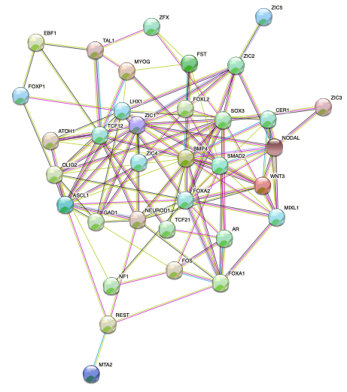
Supplementary Figure 7. STRING (https://string-db.org/) plot showing 34 interconnected proteins that demonstrate differential gene expression upon KMT2C deletion. Epigenome peaks, ATAC-seq and RNA-seq tracks for each gene in this figure are presented either in Figure 3 of the manuscript or Supplementary Figure 14.

Slide 12
Supplementary Table 2. From our transcriptome results, these are the top 100 differentially expressed genes in the KMT2CKO line compared to WT, based on adjusted p-values (not fold change) as determined by edgeR (after TMM normalization). These were the genes used in the PCA plot (Figure 1C) and demonstrated a gene expression profile in the KMT2CKO that most closely resembled mesendoderm, rather than any of the three primary germ layers.
Supplementary Figure 8. Genome-wide changes in open chromatin between WT pluripotent hiPSCs (A) and isogenic KMT2CKO hiPSCs (B) based on sequence context. Knockout of KMT2C results in a general shift from open chromatin at promoters to more open chromatin at distal regulatory sequences (“1st intron”, “other intron”, “downstream” and “distal intergenic”).

Slide 13
Supplementary Table 3: Significantly enriched TF binding motifs in WT compared to KMT2CKO
Rank | Motif Name | HOMER P-value | Transcription Factor Family
1 | CTCF | 1E-1277 | ZF
2 | BORIS/CTCFL | 1E-991 | ZF
3 | OCT4-SOX2-TCF-NANOG | 1E-689 | POU,Homeobox,HMG
4 | SOX3 | 1E-490 | HMG
5 | SOX2 | 1E-345 | HMG
6 | SOX6 | 1E-325 | HMG
7 | SOX10 | 1E-322 | HMG
8 | POU5F1/OCT4 | 1E-277 | POU,Homeobox
9 | SP1 | 1E-233 | ZF
10 | POU3F1/OCT6 | 1E-232 | POU,Homeobox
11 | SOX15 | 1E-224 | HMG
12 | POU3F3/BRN1 | 1E-219 | POU,Homeobox
13 | TEAD | 1E-216 | TEA
14 | SOX4 | 1E-201 | HMG
15 | TEAD4 | 1E-178 | TEA
16 | KLF5 | 1E-149 | ZF
17 | NFkB | 1E-139 | RHD
18 | TEAD2 | 1E-135 | TEA
19 | KLF9 | 1E-134 | ZF
20 | OCT2 | 1E-128 | Homeobox
21 | NFkB | 1E-124 | RHD
22 | SOX9 | 1E-123 | HMG
23 | KLF4 | 1E-86 | ZF
24 | KLF14 | 1E-79 | ZF
25 | “Unknown ESC element” (ZIC complementary sequence) | 1E-61 | ZF
26 | KLF10 | 1E-59 | ZF
27 | FOSL2 | 1E-54 | bZIP
28 | JUN-AP1 | 1E-54 | bZIP
29 | NANOG | 1E-51 | Homeobox
30 | AP1 | 1E-48 | bZIP
31 | ATF3 | 1E-48 | bZIP
32 | BATF | 1E-47 | bZIP
33 | NFkB | 1E-47 | RHD
34 | E2A | 1E-46 | bHLH
35 | FRA1 | 1E-44 | bZIP
36 | SIX1 | 1E-43 | Homeobox
37 | MAZ | 1E-41 | ZF
38 | NFY | 1E-38 | Nuclear Factor
39 | BACH2 | 1E-34 | bZIP
40 | ZIC | 1E-33 | ZIC
41 | LHX3 | 1E-30 | Homeobox
42 | SCL | 1E-30 | bHLH
43 | ASC11 | 1E-29 | bHLH
44 | FOXA2 | 1E-29 | Forkhead
45 | FLI1 | 1E-29 | ETS
46 | FOXP1 | 1E-24 | Forkhead
47 | IS11 | 1E-24 | Homeobox
48 | NeuroD1 | 1E-24 | bHLH
49 | ELK1 | 1E-24 | ETS
50 | ELK4 | 1E-23 | ETS
51 | EKLF | 1E-20 | ZF
52 | TGIF2 | 1E-19 | Homeobox
53 | HEB | 1E-19 | bHLH
54 | ETV1 | 1E-19 | ETS
55 | ERG | 1E-19 | ETS
56 | ELF1 | 1E-19 | ETS
57 | EGR2 | 1E-19 | ZF
58 | X-box | 1E-18 | HTH
59 | MYB | 1E-18 | HTH
60 | PRDM | 1E-18 | ZF
61 | CEBP-AP1 | 1E-18 | bZIP
62 | RFX | 1E-18 | HTH
63 | ETS1 | 1E-17 | ETS
64 | MafA | 1E-17 | bZIP
65 | NFAT | 1E-17 | RHD
66 | Rfx2 | 1E-17 | HTH
67 | FOX-Ebox | 1E-17 | Forkhead
68 | REST-NRSF | 1E-17 | ZF
69 | PTF1A | 1E-16 | bHLH
70 | ETS | 1E-16 | ETS
71 | GABPA | 1E-15 | ETS
72 | P53 | 1E-15 | P53
73 | GFY-Staf | 1E-15 | ZF
74 | SPDEF | 1E-14 | ETS
75 | RFX1 | 1E-14 | HTH
76 | EHF | 1E-14 | ETS
77 | FOXA1 | 1E-14 | Forkhead
78 | CTCF-Satellite element | 1E-14 | ZF
79 | OCT4-SOX17 | 1E-14 | Homeobox
80 | LHX2 | 1E-14 | Homeobox
81 | MafF | 1E-14 | bZIP
82 | EWS-FLI1 | 1E-14 | ETS
83 | EGR1 | 1E-13 | ZF
84 | LHX1 | 1E-13 | Homeobox
85 | RUNX2 | 1E-13 | RUNT
86 | EOMES | 1E-13 | T-box
87 | NRF | 1E-13 | NRF

Slide 14
Supplementary Table 4: ATAC-seq significantly enriched TF motifs in KMT2CKO (n=123)
Rank | Motif Name | p value | Transcription Factor Family
1 | ZIC | 1E-1097 | ZF
2 | “Unknown ESC element” (ZIC complementary sequence) | 1E-922 | ZF
3 | OCT4 | 1E-618 | Homeobox
4 | OCT4-SOX2-TCF-NANOG | 1E-591 | POU,Homeobox,HMG
5 | SOX3 | 1E-468 | HMG
6 | POU3F3/BRN1 | 1E-455 | POU,Homeobox
7 | POU3F1/OCT6 | 1E-442 | POU,Homeobox
8 | ERG | 1E-380 | ETS
9 | SOX10 | 1E-364 | HMG
10 | SOX2 | 1E-349 | HMG
11 | FLI1 | 1E-337 | ETS
12 | ETV2 | 1E-317 | ETS
13 | SOX6 | 1E-312 | HMG
14 | ETV1 | 1E-299 | ETS
15 | ETS1 | 1E-293 | ETS
16 | CTCF | 1E-277 | ZF
17 | TAL1/SCL | 1E-273 | bHLH
18 | OCT2 | 1E-259 | Homeobox
19 | GABPA | 1E-232 | ETS
20 | SOX15 | 1E-230 | HMG
21 | EWS-ERG | 1E-224 | ETS
22 | EWS-FLI1 | 1E-223 | ETS
23 | SOX4 | 1E-210 | HMG
24 | BORIS/CTCFL | 1E-206 | ZF
25 | TEAD4 | 1E-205 | TEA
26 | EHF | 1E-190 | ETS
27 | RFX | 1E-188 | HTH
28 | RFX2 | 1E-175 | HTH
29 | ETS1 | 1E-170 | ETS
30 | MafA | 1E-161 | bZIP
31 | Jun-AP1 | 1E-161 | bZIP
32 | TCF4 | 1E-156 | HMG
33 | SPDEF | 1E-152 | ETS
34 | OTX2 | 1E-144 | Homeobox
35 | Bach2 | 1E-139 | bZIP
36 | TEAD | 1E-138 | TEA
37 | FOSL2 | 1E-134 | bZIP
38 | FRA1 | 1E-133 | bZIP
39 | TEAD2 | 1E-128 | TEA
40 | TCF3 | 1E-125 | HMG
41 | ATF3 | 1E-124 | bZIP
42 | ELF1 | 1E-121 | ETS
43 | FOXA2 | 1E-121 | Forkhead
44 | SOX9 | 1E-121 | HMG
45 | AP1 | 1E-117 | bZIP
46 | BATF | 1E-116 | bZIP
47 | FOXH1 | 1E-116 | Forkhead
48 | LHX3 | 1E-115 | Homeobox
49 | Nanog | 1E-114 | Homeobox
50 | Nkx6 | 1E-113 | Homeobox
51 | ELK1 | 1E-113 | ETS
52 | FOXO1 | 1E-112 | Forkhead
53 | MafK | 1E-107 | bZIP
54 | PU.1 | 1E-102 | ETS
55 | ELF5 | 1E-96 | ETS
56 | X-box | 1E-96 | HTH
57 | NF-E2 | 1E-94 | bZIP
58 | Bach1 | 1E-91 | bZIP
59 | RFX1 | 1E-90 | HTH
60 | FOX-Ebox | 1E-86 | Forkhead
61 | TCF12 | 1E-83 | bHLH
62 | NRF2 | 1E-81 | bZIP

Slide 15
Supplementary Table 4-continued: ATAC-seq significantly enriched TF motifs in KMT2CKO (n=123)
Rank | Motif Name | p value | Transcription Factor Family
63 | ETS | 1E-81 | ETS
64 | ELK4 | 1E-79 | ETS
65 | FOXA1 | 1E-79 | Forkhead
66 | IS11 | 1E-79 | Homeobox
67 | FOXA1 | 1E-78 | Forkhead
68 | ZNF467 | 1E-73 | ZF
69 | FOXP1 | 1E-70 | Forkhead
70 | LHX2 | 1E-69 | Homeobox
71 | AP4 | 1E-64 | bHLH
72 | FOXM1 | 1E-62 | Forkhead
73 | LHX1 | 1E-61 | Homeobox
74 | Maz | 1E-59 | ZF
75 | TGIF1 | 1E-56 | Homeobox
76 | FOXL2 | 1E-54 | Forkhead
77 | EBF1 | 1E-54 | EBF
78 | RFX5 | 1E-52 | HTH
79 | NFY | 1E-52 | Nuclear Factor
80 | MYOD | 1E-51 | bHLH
81 | Pit1 | 1E-48 | Homeobox
82 | RUNX-AML | 1E-48 | Runt
83 | SP1 | 1E-45 | ZF
84 | EOMES | 1E-44 | T-box
85 | TCFL2 | 1E-42 | HMG
86 | TCF21 | 1E-41 | bHLH
87 | MYB | 1E-39 | HTH
88 | MYOG | 1E-37 | bHLH
89 | AMYB | 1E-37 | HTH
90 | BMYB | 1E-34 | HTH
91 | KLF14 | 1E-34 | ZF
92 | RUNX2 | 1E-33 | Runt
93 | Myf5 | 1E-33 | bHLH
94 | Six1 | 1E-30 | Homeobox
95 | Gata4 | 1E-28 | ZF
96 | TGIF2 | 1E-28 | Homeobox
97 | RUNX1 | 1E-27 | Runt
98 | REST-NRSF | 1E-26 | ZF
99 | OLIG2 | 1E-26 | bHLH
100 | RUNX | 1E-25 | Runt
101 | TLX | 1E-25 | NR
102 | TBX20 | 1E-24 | T-box
103 | Meis1 | 1E-24 | Homeobox
104 | CEBP:AP1 | 1E-24 | bZIP
105 | SpiB | 1E-23 | ETS
106 | Smad3 | 1E-22 | MAD
107 | EBF | 1E-21 | EBF
108 | CTCf-Satellite element | 1E-19 | ZF
109 | Bcl6 | 1E-19 | ZF
110 | PRDM9 | 1E-18 | ZF
111 | Znf263 | 1E-18 | ZF
112 | ASC11 | 1E-17 | bHLH
113 | OCT4-SOX17 | 1E-17 | Hoemobox,HMG
114 | Brachyury | 1E-17 | T-box
115 | KLF9 | 1E-16 | ZF
116 | Pbx3 | 1E-15 | Homeobox
117 | ATOH1 | 1E-15 | bHLH
118 | ETS:E-box | 1E-14 | ETS
119 | Pkonx1 | 1E-14 | Homeobox
120 | RBPJ:E-box | 1E-14 | bHLH
121 | Gata2 | 1E-13 | ZF
122 | CRX | 1E-13 | Homeobox
123 | Smad2 | 1E-13 | MAD

Slide 16
Supplementary Table 5: Histone modifications used to define gene regulatory elements
Regulatory element | Histone modifications | Genomic Loci
Primed enhancers | H3K4me1 only | Within 500 kb of TSS
Active enhancers | Overlapping H3K4me1 and H3K27ac peaks | Within 500 kb of TSS
Poised enhancers | Overlapping H3K4me1 and H3K27me3 peaks | Within 500 kb of TSS
Active promoters | H3K4me3 only | Within 1kb of TSS
Bivalent promoters | Overlapping H3K4me3 and H3K27me3 peaks | Within 1kb of TSS

Slide 17
Supplementary Figure 9. Differences in histone modifications between WT and KMT2CKO are site-specific and enriched at enhancers relative to promoters.

Slide 18
Supplementary Figure 10. Genome-wide differences in the active enhancer (AE) landscape and gene ontology following KMT2C knockout.
A) Venn diagram of genome-wide AE marks
B) GO terms associated with AE in WT only
Total: 29,161 AE marks
C) GO terms associated with AE in KMT2CKO only

Slide 19
Supplementary Figure 11. Genome-wide differences in the poised enhancer (PE) landscape and gene ontology following KMT2C knockout.
A) Venn diagram of genome-wide PE marks
B) GO terms associated with PE in WT only
Total: 24,689 PE marks
C) GO terms associated with PE in KMT2CKO only

Slide 20
Supplementary Figure 12. Venn diagram demonstrating genome-wide differences in bivalent promoter marks between WT and KMT2CKO
Total: 5,568 bivalent promoter marks

Slide 21
Supplementary Figure 13. Gene expression is associated with active enhancers more so than any other type of enhancer (A,B) and the more active enhancers associated with a gene, the greater the gene expression (C,D).
WILD TYPE
KMT2CKO
*
n.s.
*
*
*
n.s.
*
*
n.s. = not significant
* = <0.001
A
*
*
B
*
*
Relative expression
Type of enhancer
*
*
*
*
n.s.
*
*
n.s.
n.s. = not significant
* = <0.001
C
*
*
D
*
*
Relative expression
Number of active enhancers associated with a gene

Slide 22
Supplementary Table 6. RNA expression differences by enhancer types in WT and KMT2CKO
Supplementary Table 7. Pairwise differences between gene expression and their associated enhancer type (tested for honest significant difference).

Slide 23
Supplementary Table 8. RNA expression differences by the number of active enhancers associated with each gene for both WT and KMT2CKO
Supplementary Table 9. Pairwise differences between the number of active enhancers and the relative amount of gene expression (tested for honest significant difference).

Slide 24
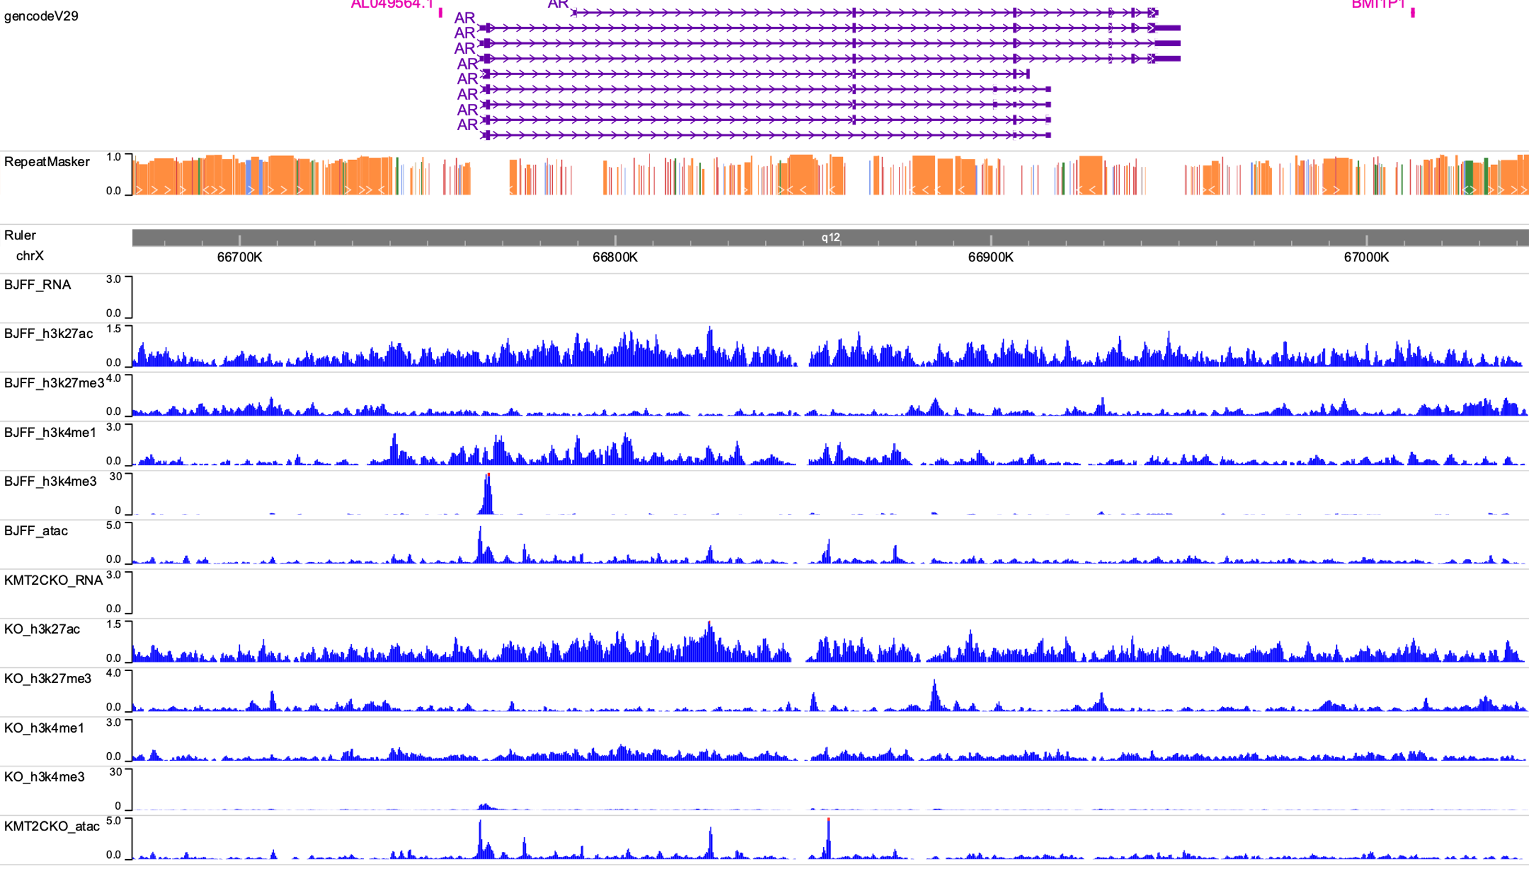
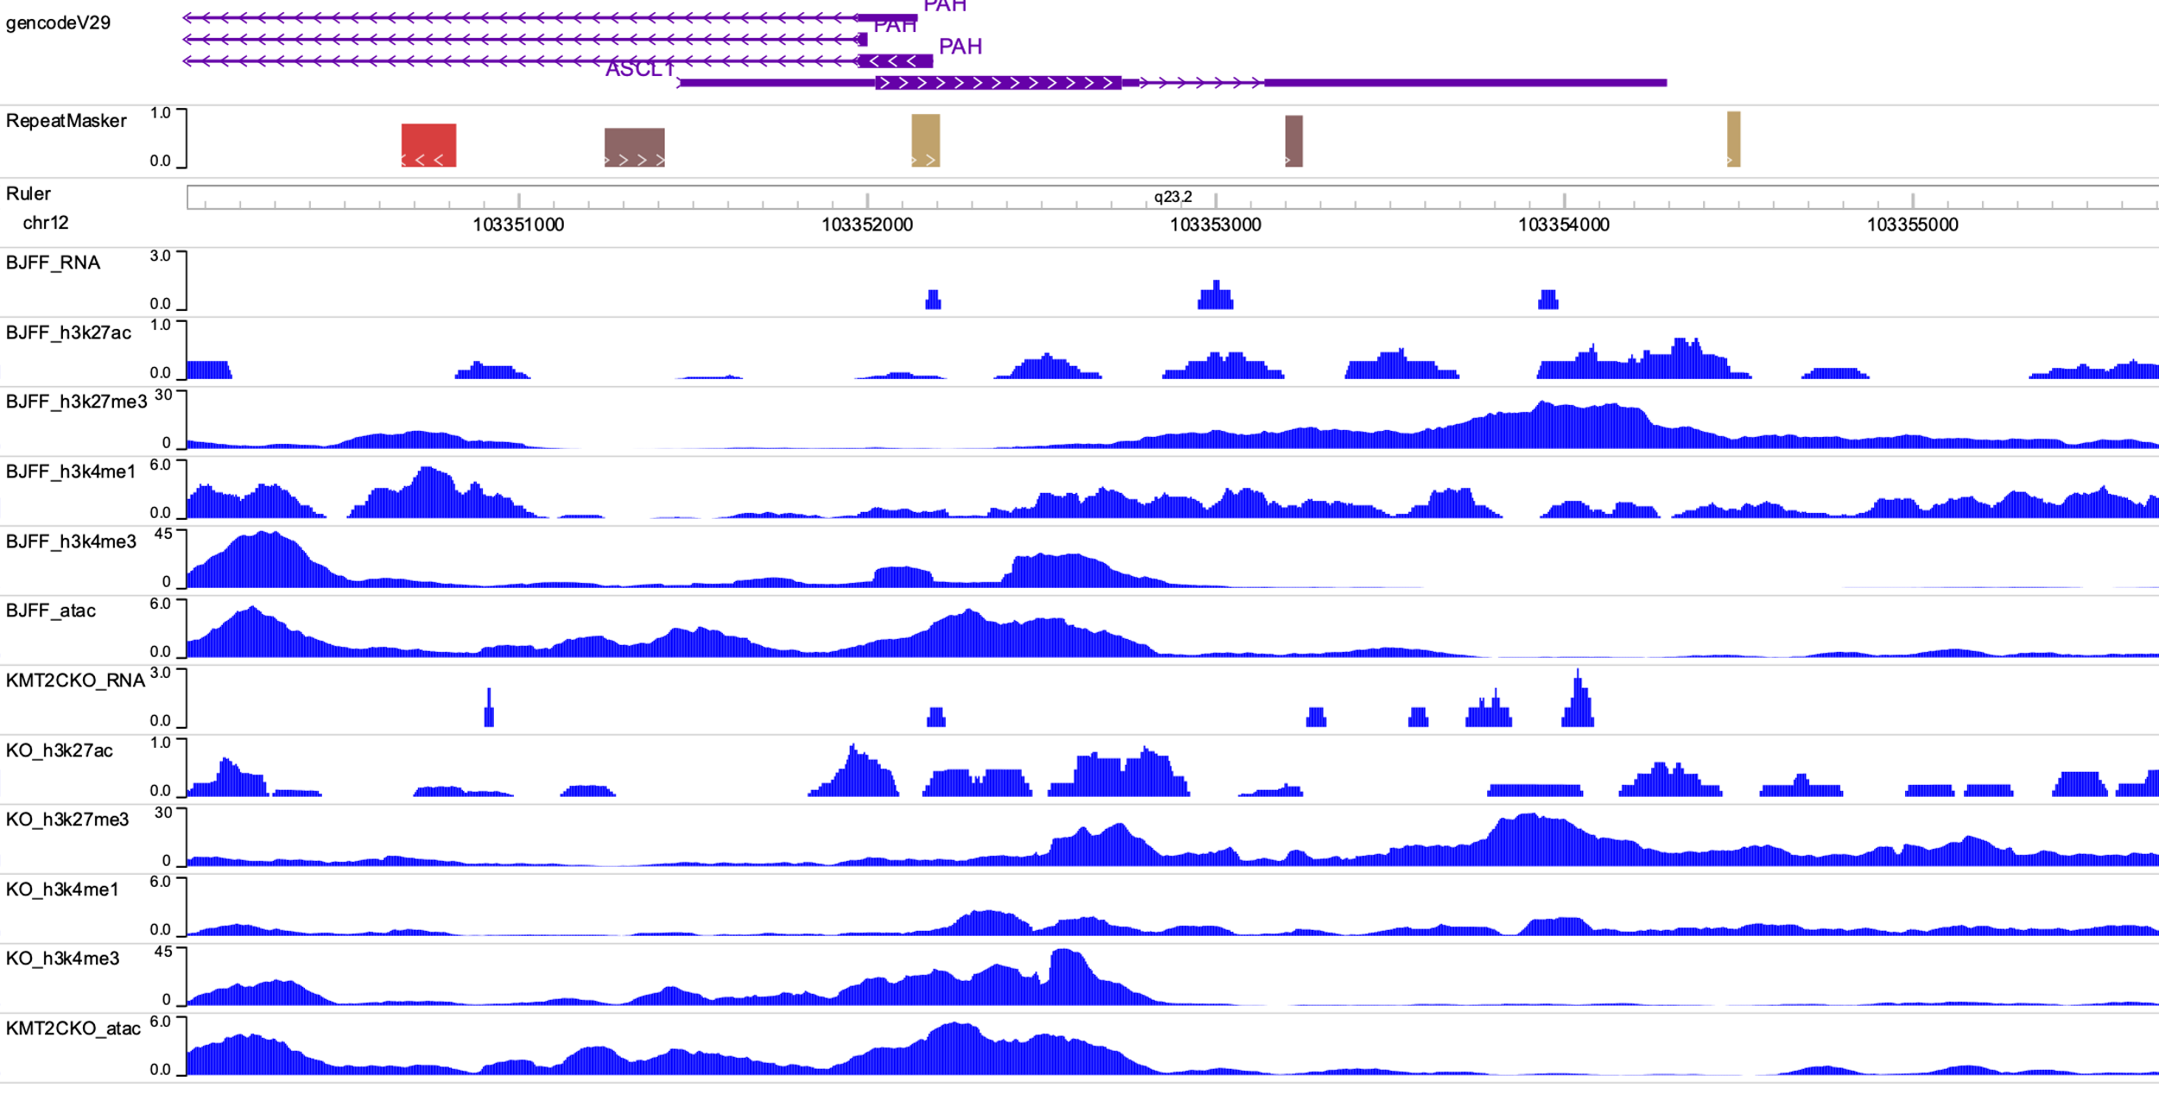
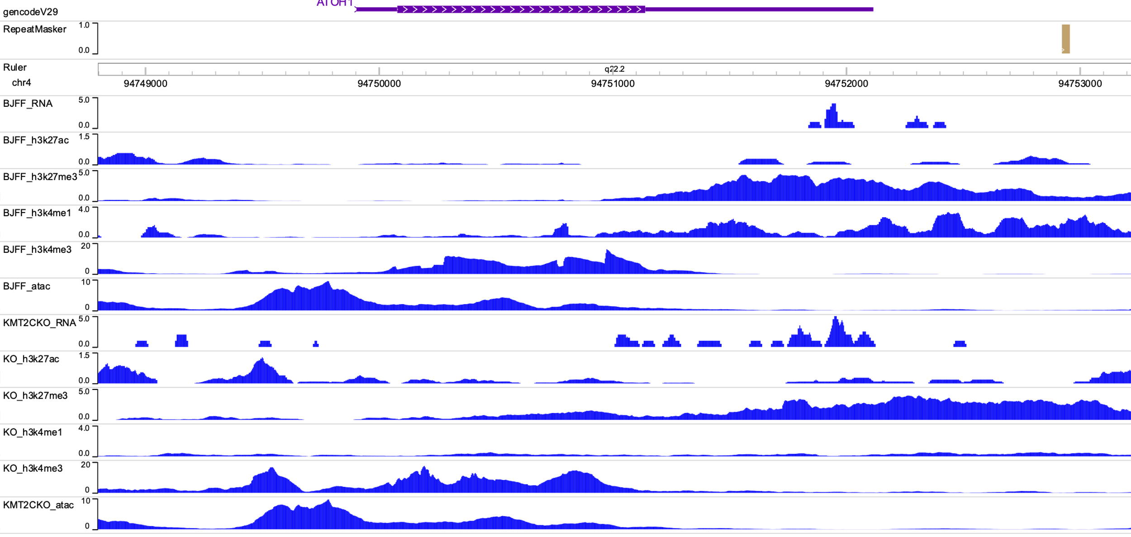
Supplementary Figure 14. Epigenome tracks for the genes shown in the STRING image of Supplementary Figure 6. Each panel shows the comparison between WT (BJFF) and KMT2CKO (KO) for RNA-seq, ChIPmentation of H3K27ac / H3K27me3 / H3K4me1 / H3K4me3, and ATAC-seq.
A. AR
B. ASCL1
C. ATOH1

Slide 25
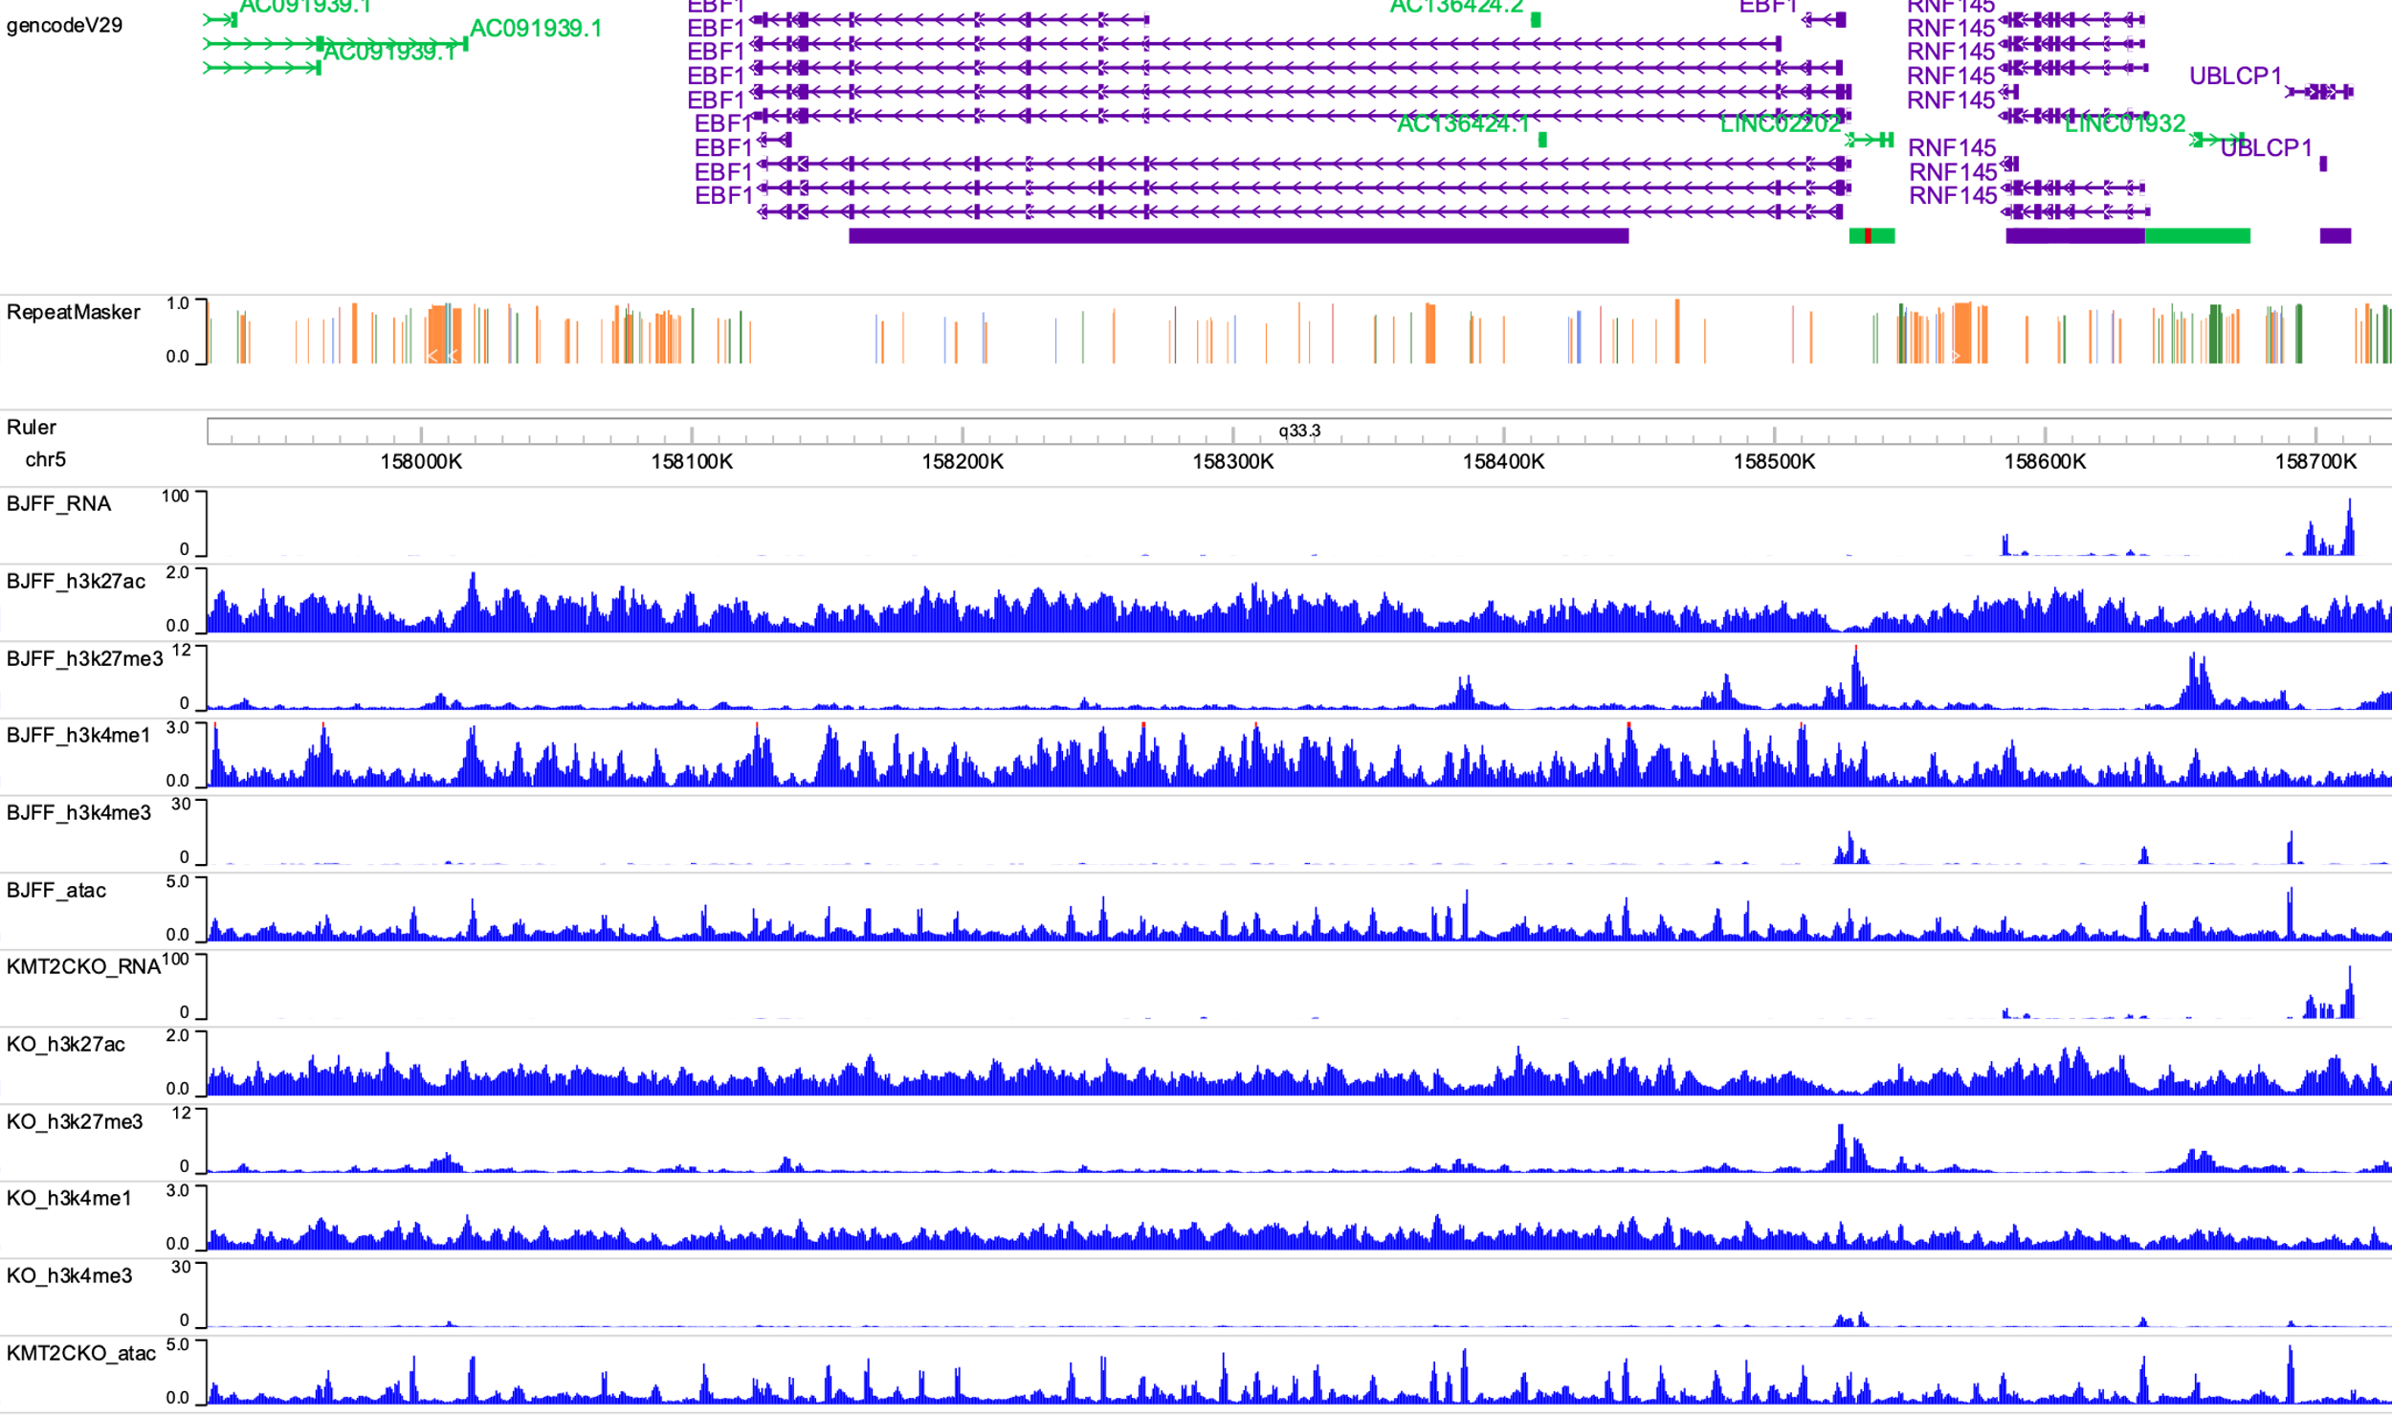
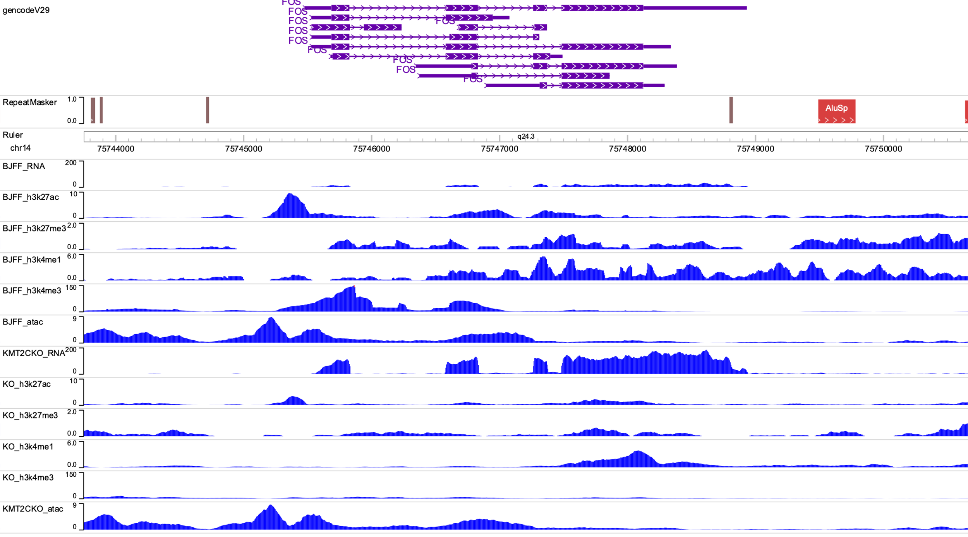
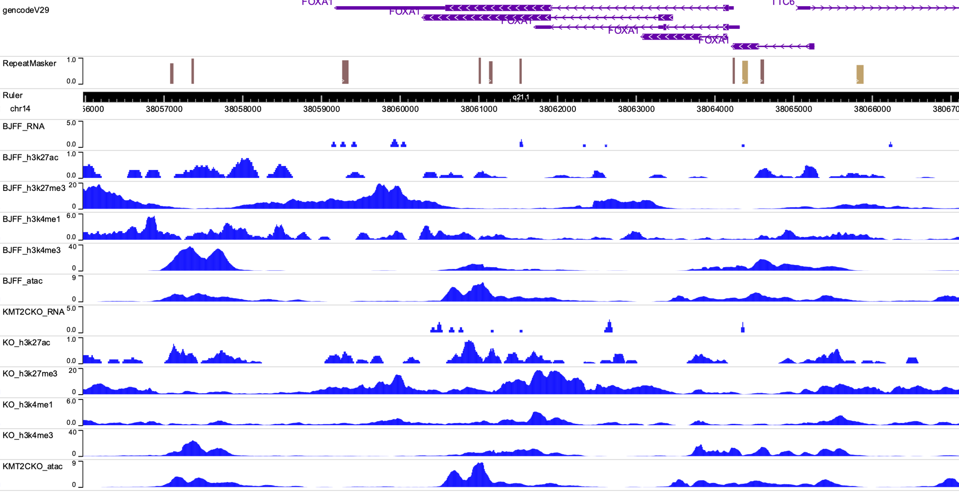
D. EBF1
E. FOS
F. FOXA1

Slide 26
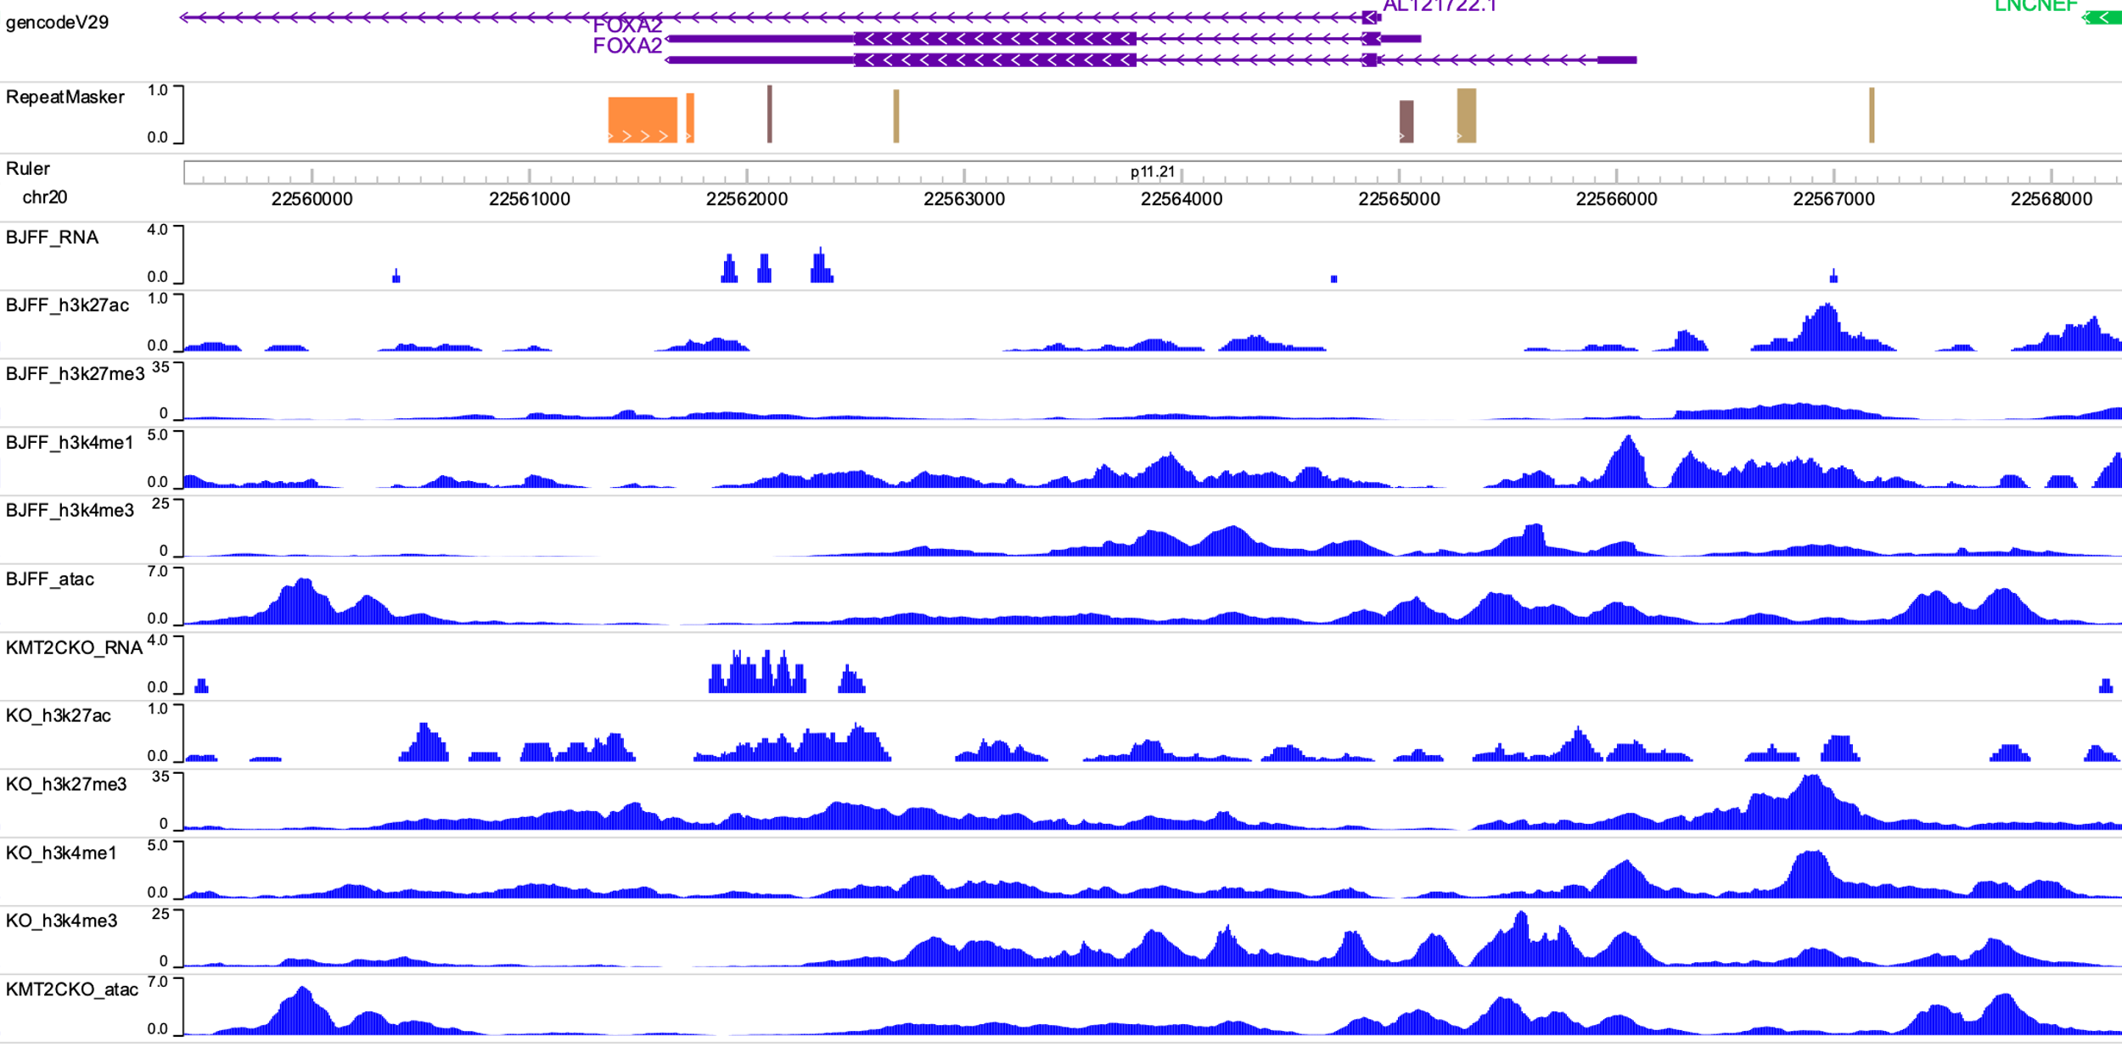
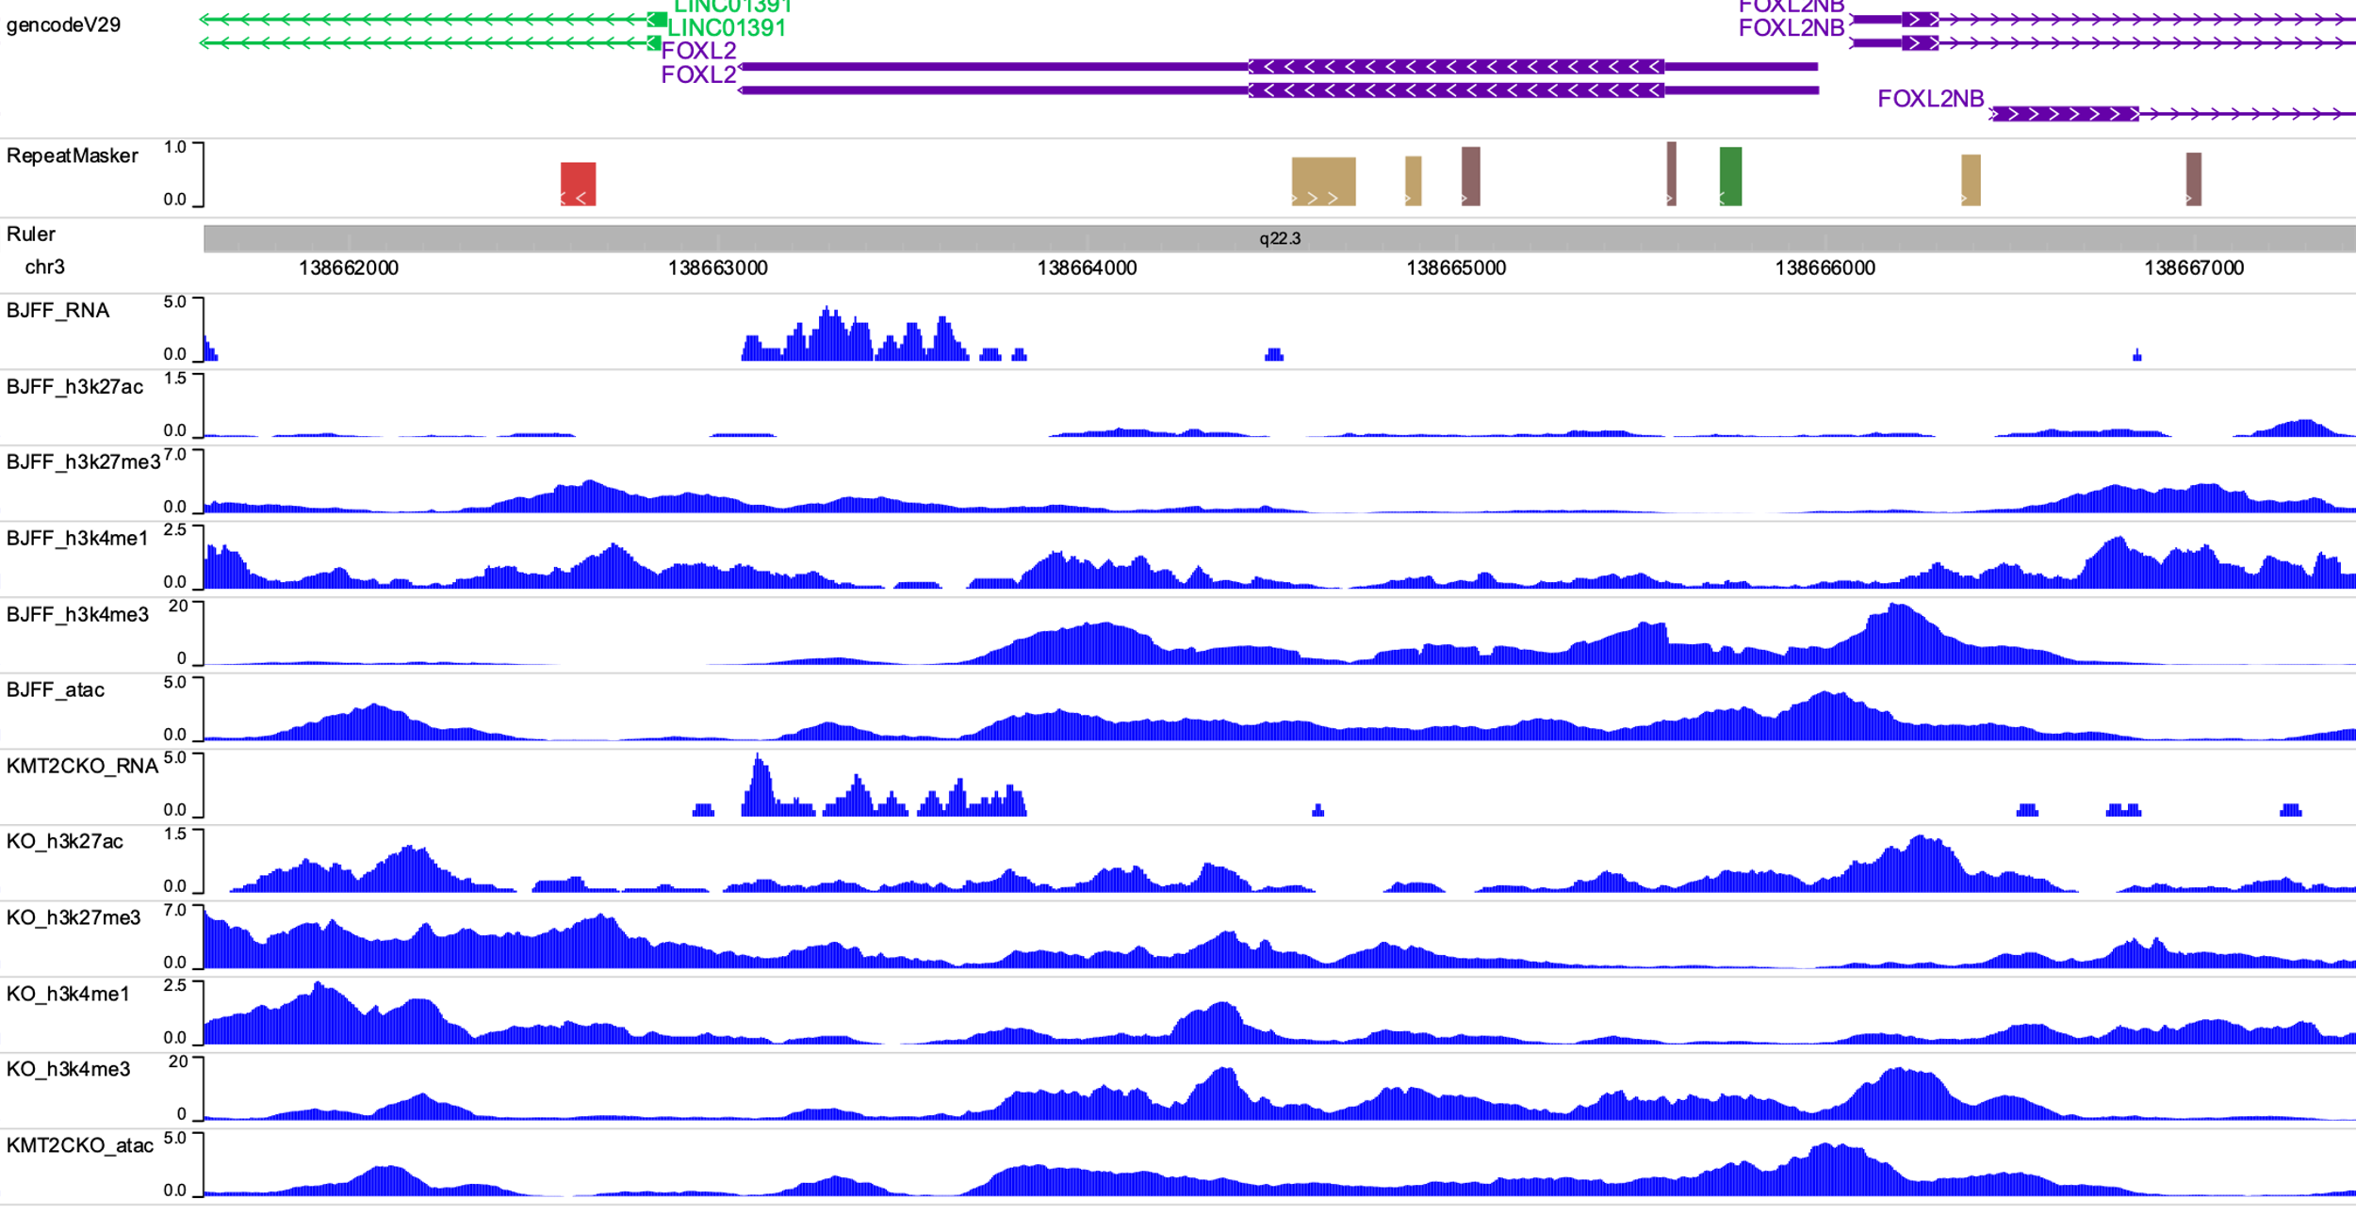
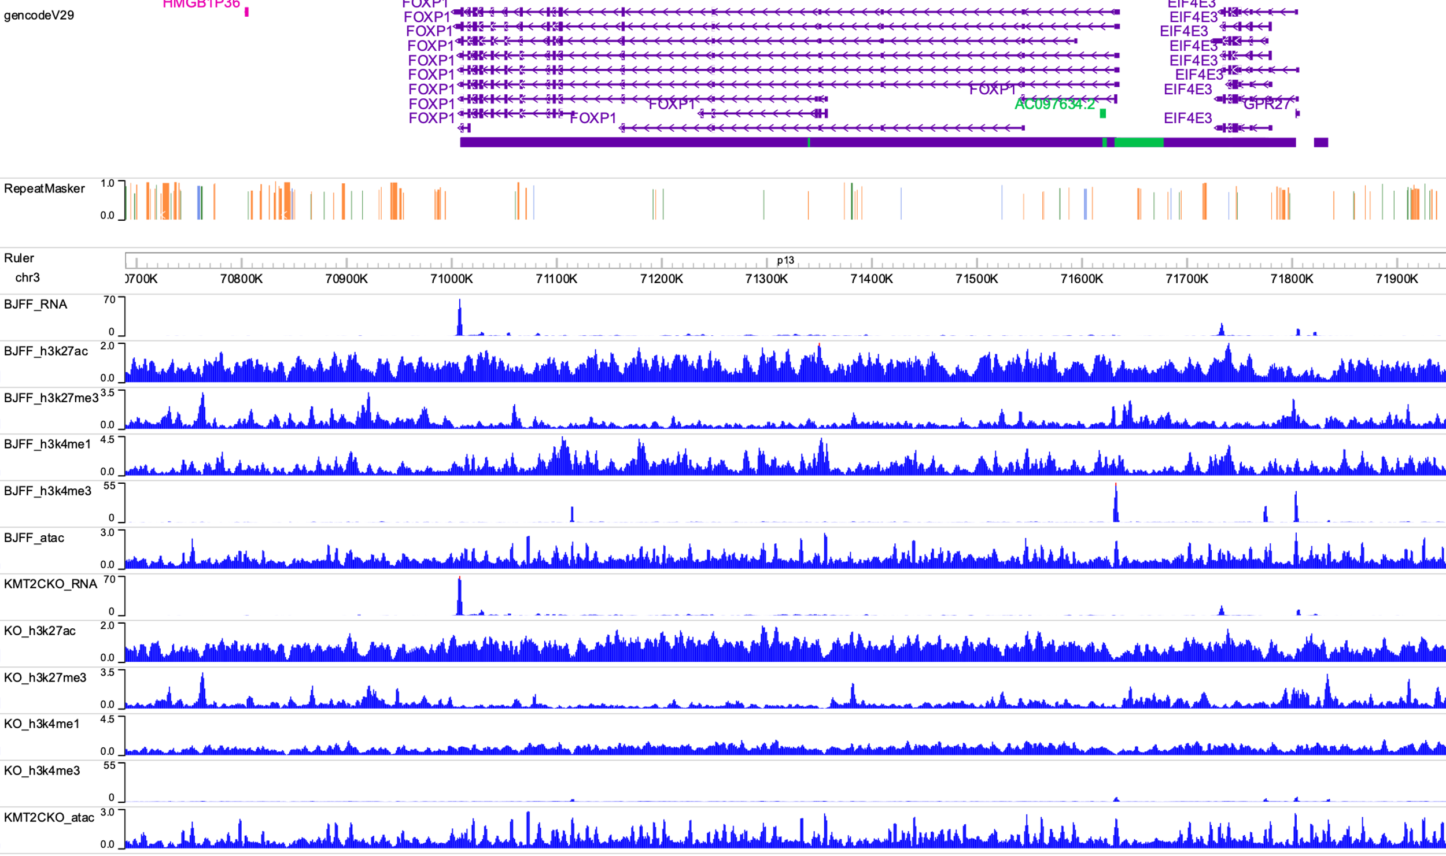
G. FOXA2
H. FOXL1
I. FOXP1

Slide 27
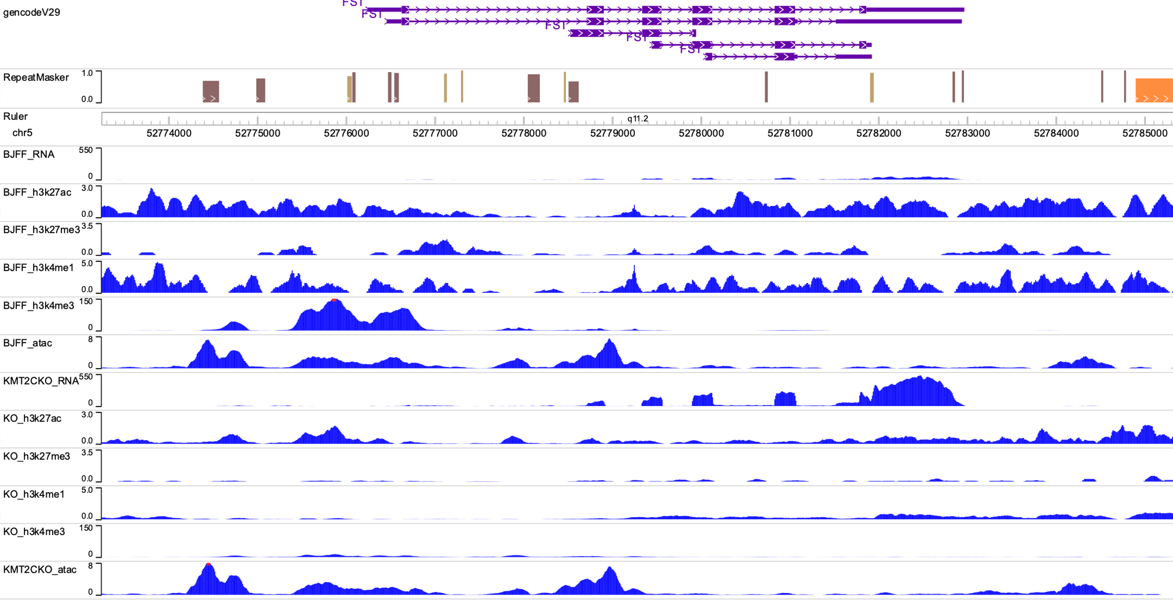
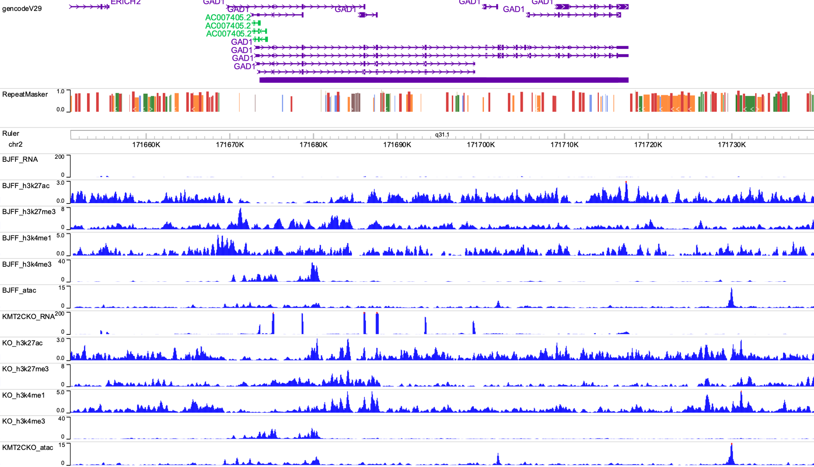
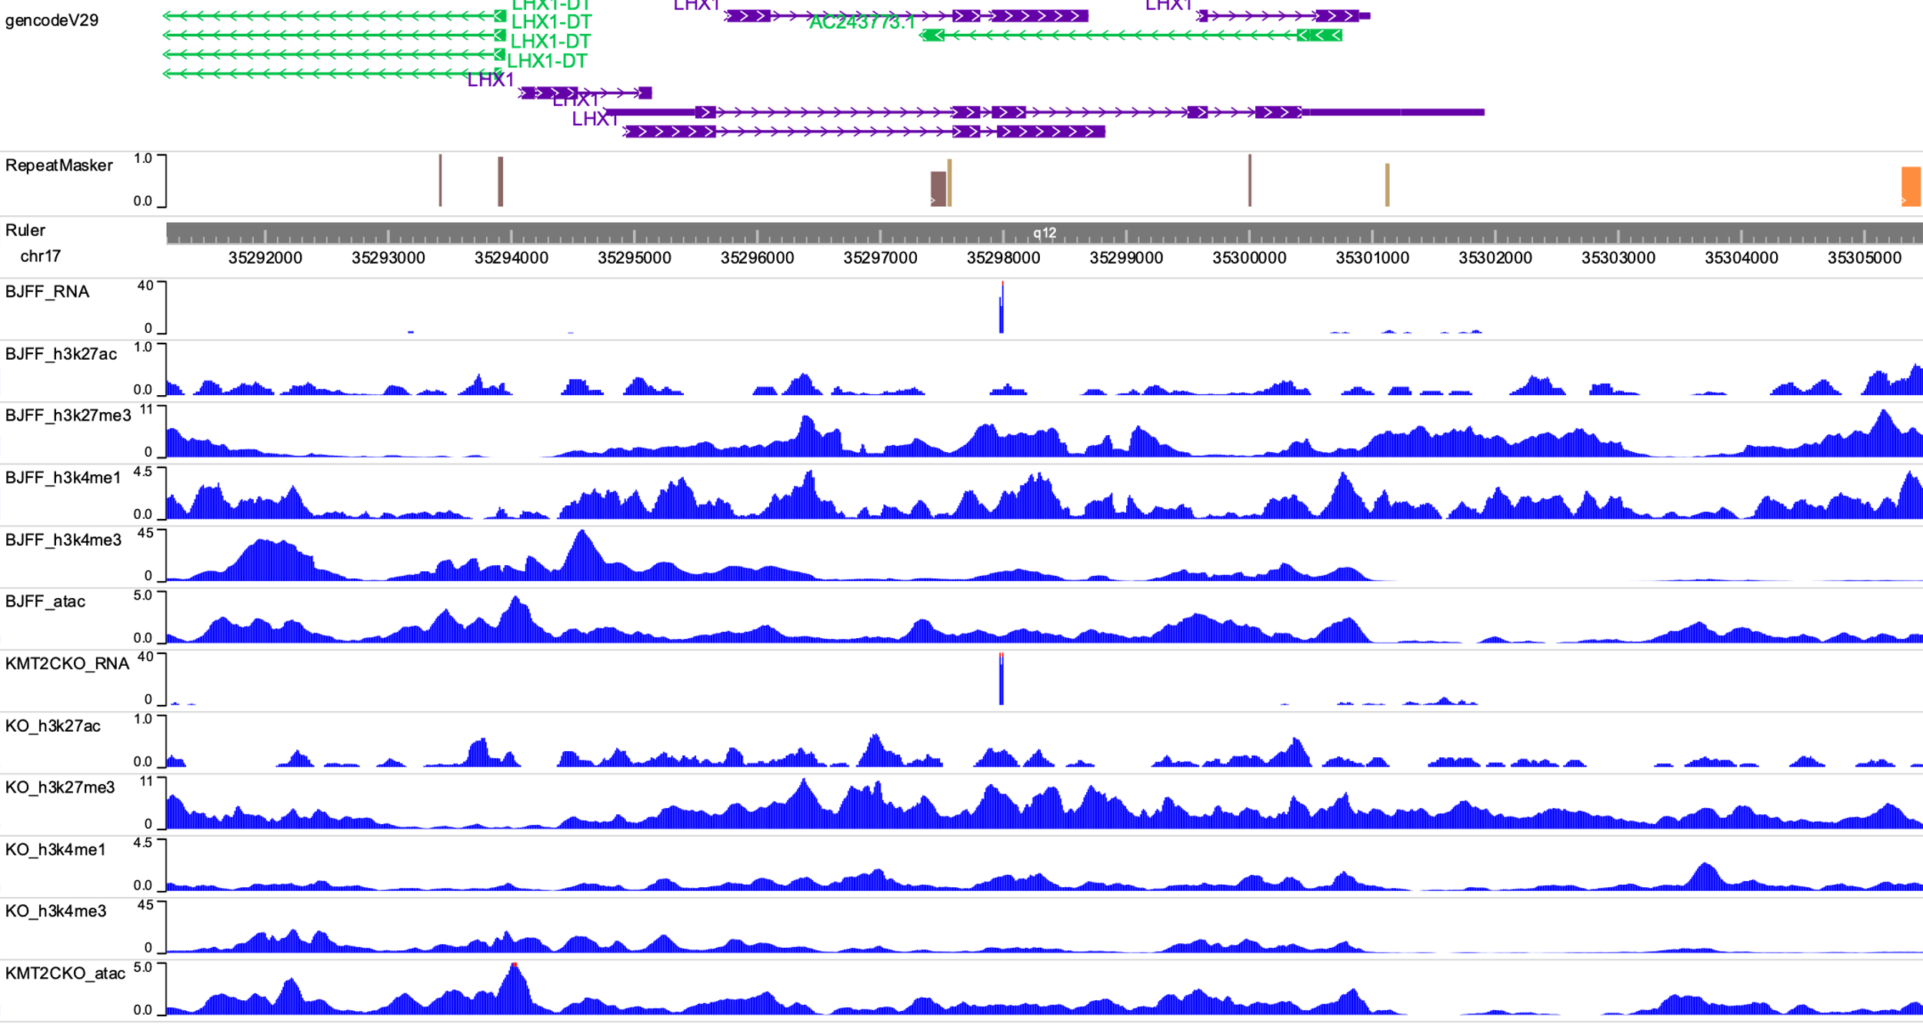
J. FST
K. GAD1
L. LHX1

Slide 28
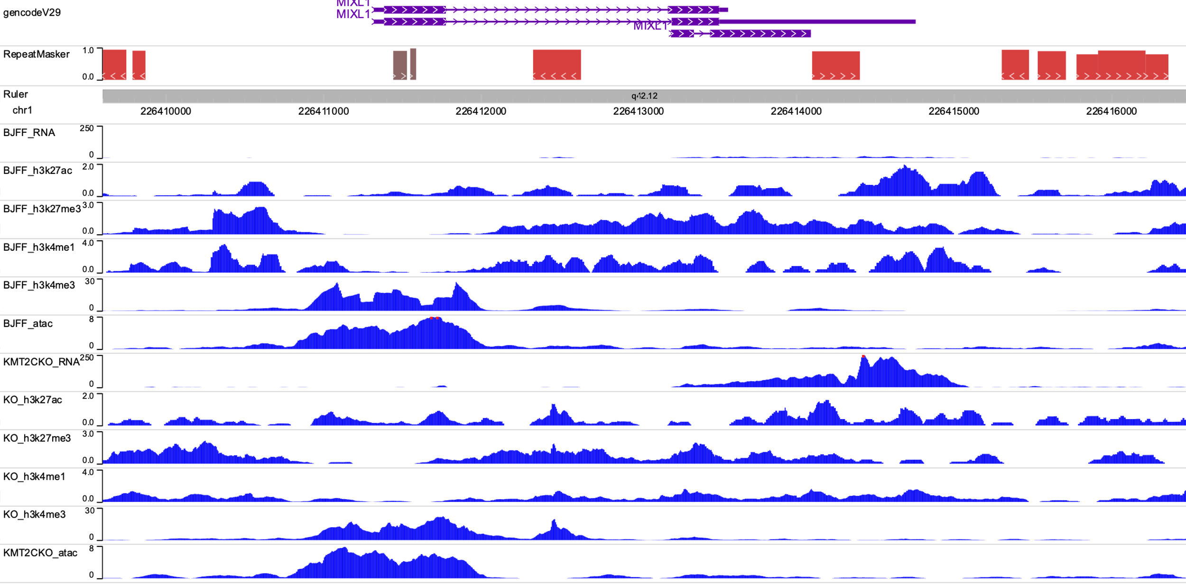
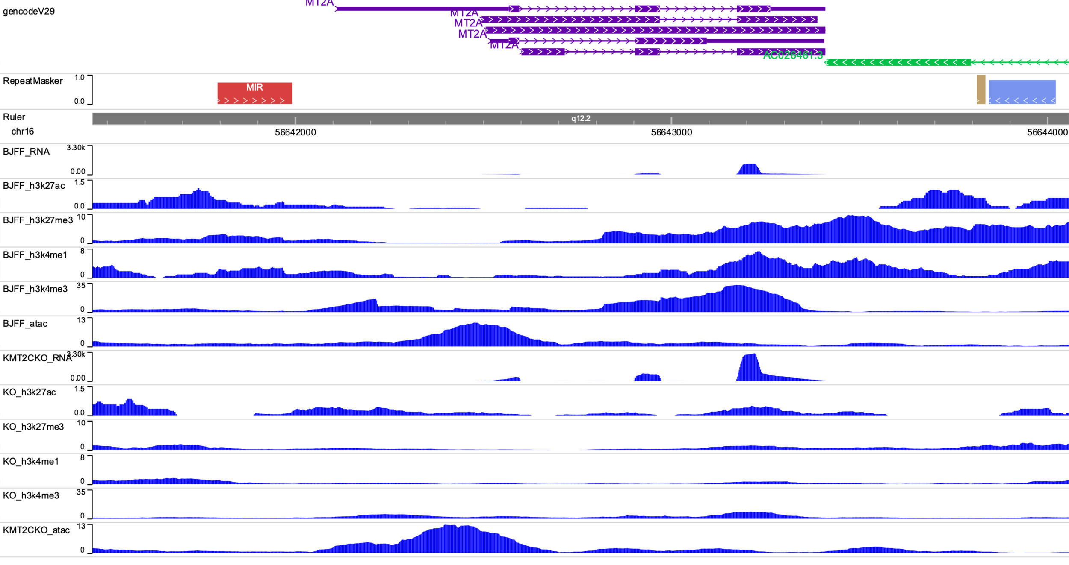
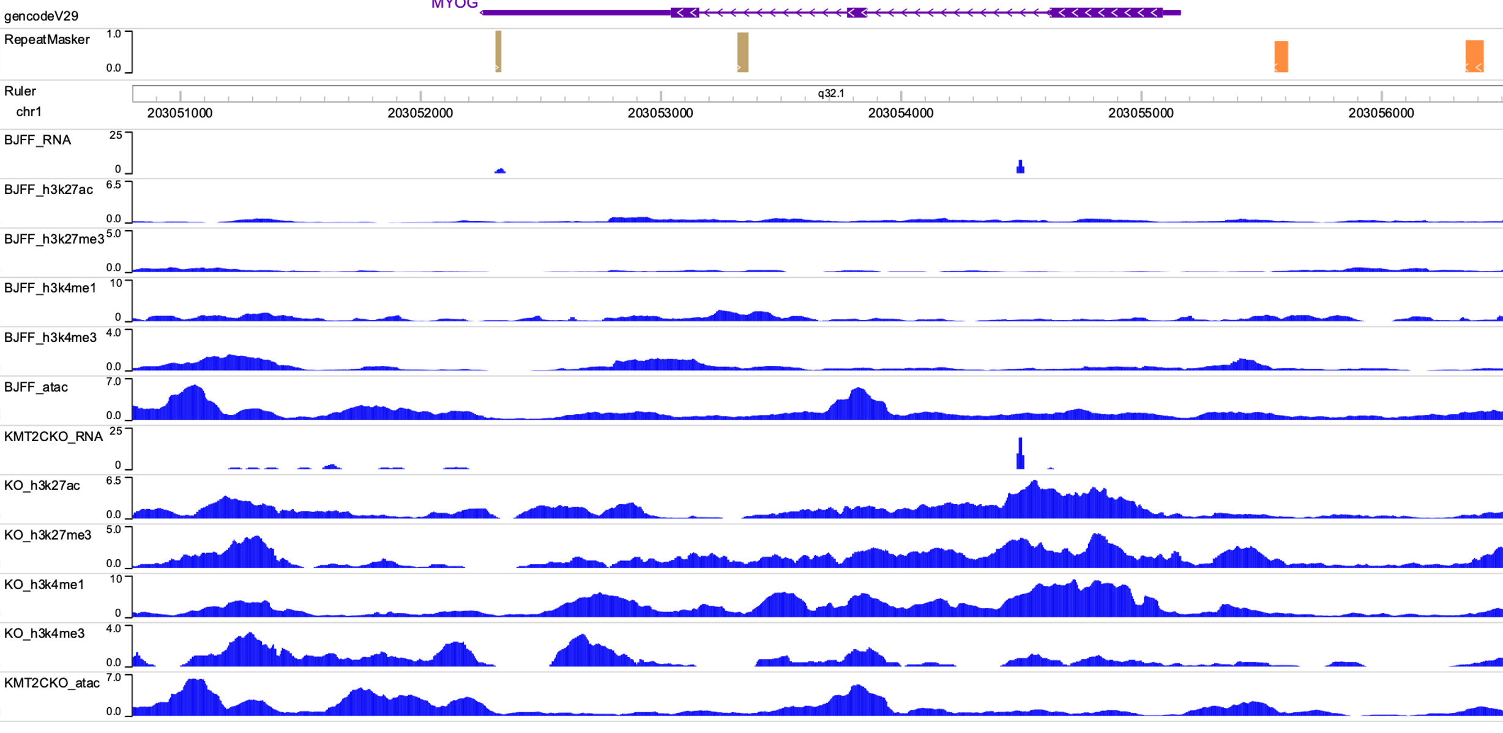
M. MIXL1
N. MTA2
O. MYOG

Slide 29
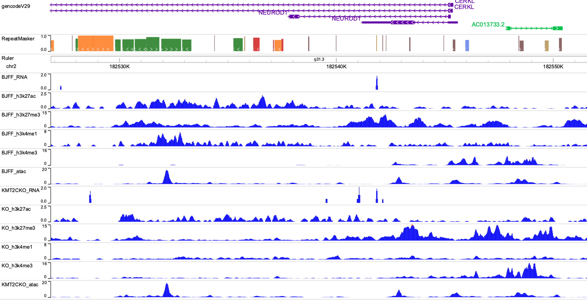
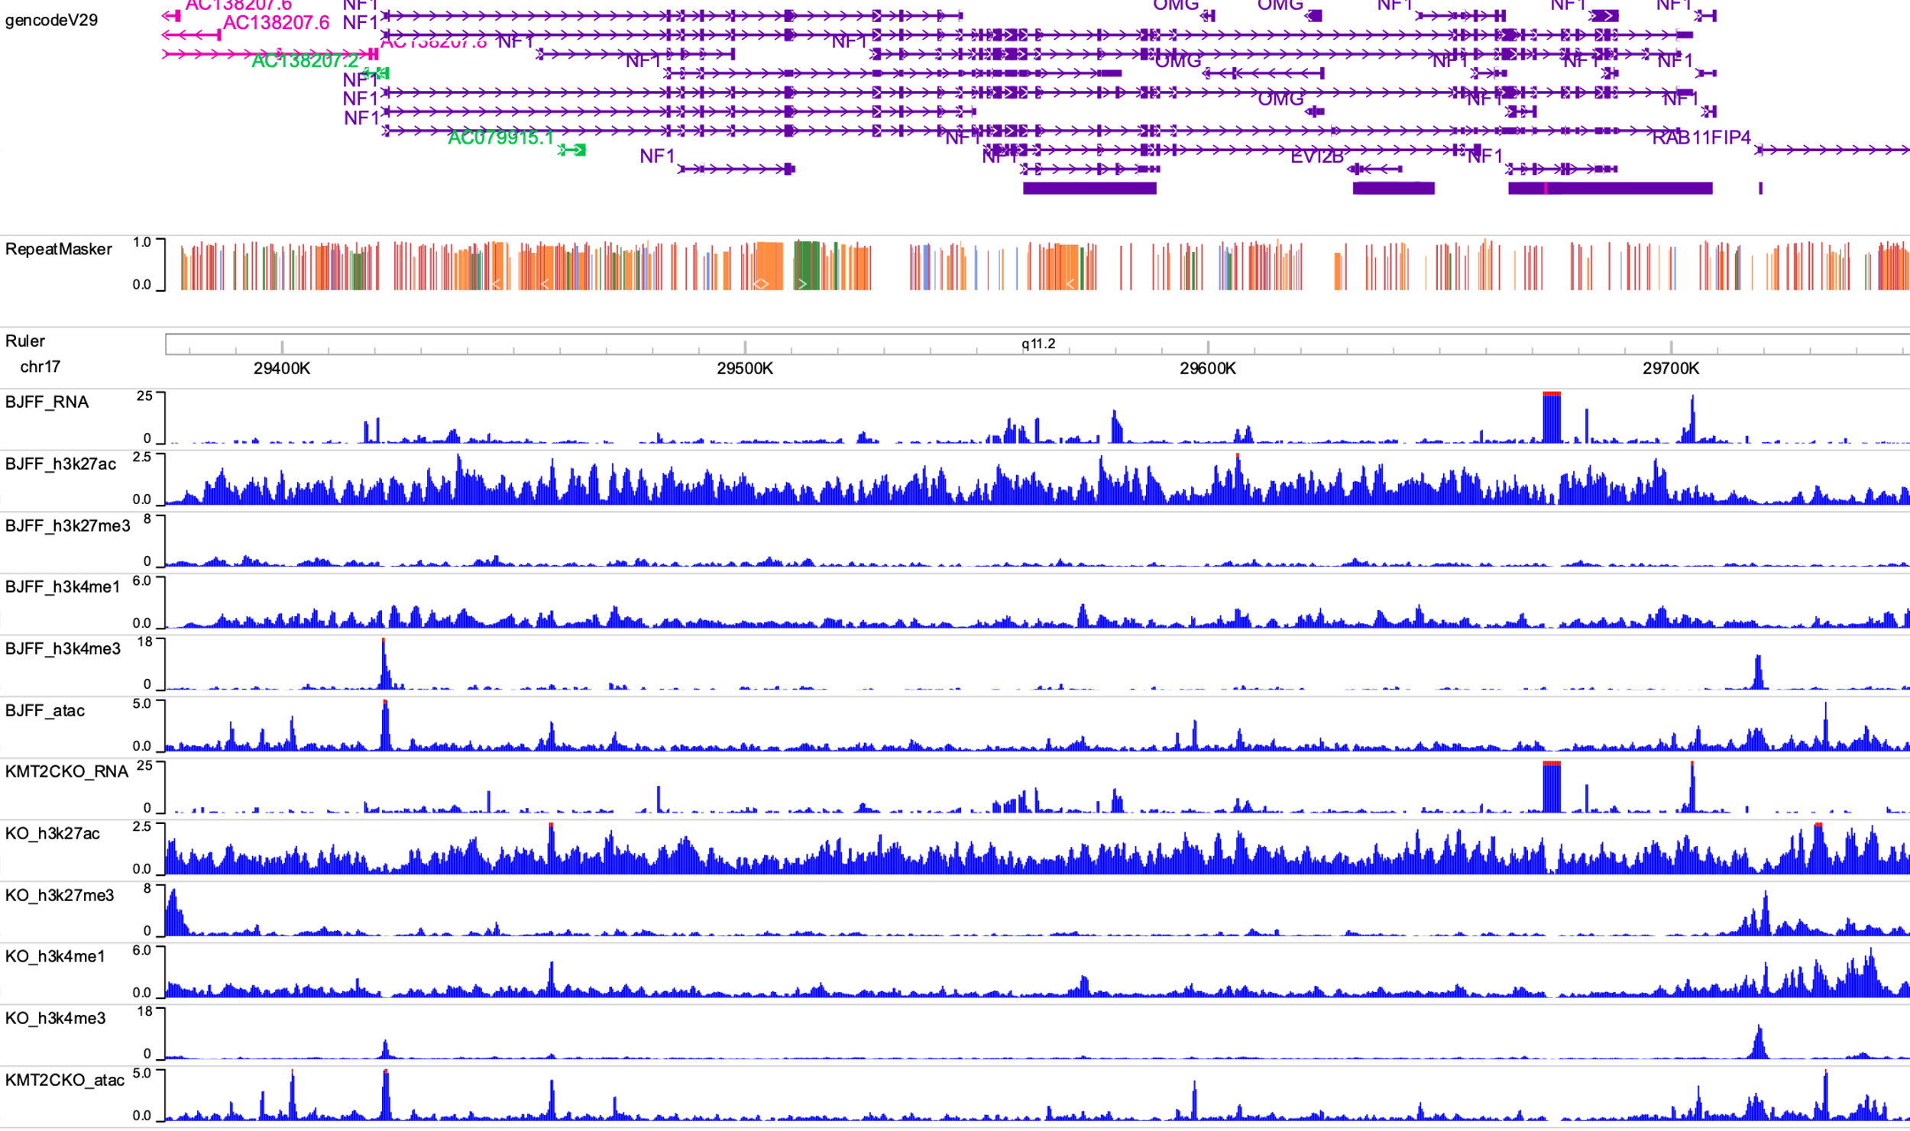

P. NEUROD1
Q. NF1
R. OLIG2

Slide 30



S. REST
T. SMAD2
U. SOX3

Slide 31



V. TAL1
W. TCF12
X. TCF21

Slide 32


Y. ZFX
Z. ZIC1 and ZIC4

Slide 33



AA. ZIC2
AB. ZIC3
AC. ZIC5

Slide 34
Supplementary Figure 15. Proteomic and Phopho-proteomic analyses. Mass spectrometry was performed to compare protein (A,B) and phospho-protein (C,D) between WT and KMT2CKO pluripotent cells. A weak but significant positive correlation was observed between gene expression and protein translation (E).

Slide 35
Supplementary Table 10A. Proteins demonstrating upregulated expression in KMT2CKO compared to WT.

Slide 36
Supplementary Table 10B. Proteins demonstrating downregulated expression in KMT2CKO compared to WT.

Slide 37
Supplementary Table 11A. Phospho-proteins demonstrating upregulated expression in KMT2CKO compared to WT.

Slide 38
Supplementary Table 11B. Phospho-proteins demonstrating downregulated expression in KMT2CKO compared to WT.

Slide 39
Supplementary Table 13. Protein content determination by the bicinchoninic acid (BCA) method.
Supplementary Table 12: We have applied the Generally Applicable Gene-set Enrichment (GAGE) methodology (https://bmcbioinformatics.biomedcentral.com/articles/10.1186/1471-2105-10-161) to perform pathway analysis for gene ontology (GO) NODAL and WNT signaling pathways, as well as the KEGG (Kyoto Encyclopedia of Genes and Genomes) WNT signaling pathway. All proved to have significant raw P-values of <0.05. While two of these analyses have an FDR >0.05, FDR is only relevant when considering all KEGG and GO Biological Processes pathways and asking if any pathways are enriched from the total. Raw P-values are used to test specific pathways. Thus, these results indicate enrichment in these pathways.
Term_ID (KEGG) | set.size | mean_logFC | P.value | FDR
hsa04310 WNT signaling pathway | 112 | 2.42508583 | 0.00813714 | 0.25457619
Term_ID (GO biological processes) | set.size | mean_logFC | P.value | FDR
GO:0016055 WNT signaling pathway | 391 | 3.55203068 | 0.00020361 | 0.02379266
GO:0198738 cell-cell signaling by WNT | 392 | 3.57972378 | 0.0001835 | 0.02313605
GO:0038092 NODAL signaling pathway | 11 | 1.77613196 | 0.04910764 | 0.35417441
 | Date | Protein Concentration (µg/µl) | Total protein (µg)
Control 1 | 2/1/2019 | 5.17 | 1033
Control 2 | 4/2/2019 | 4.37 | 1310
Control 3 | 4/2/2019 | 2.38 | 475
KMT2CKO_1 | 4/2/2019 | 3.27 | 655
KMT2CKO_2 | 4/2/2019 | 3.47 | 1041
KMT2CKO_3 | 4/2/2019 | 3.34 | 669

